Slide 1
Segurança Forense
Seminário
2019
Nuno Santos

Slide 2
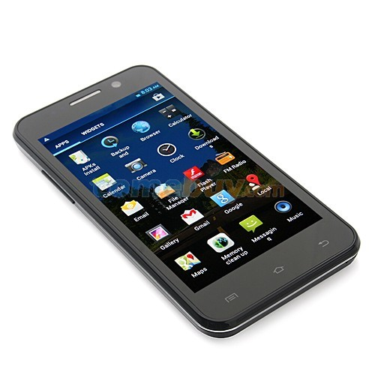
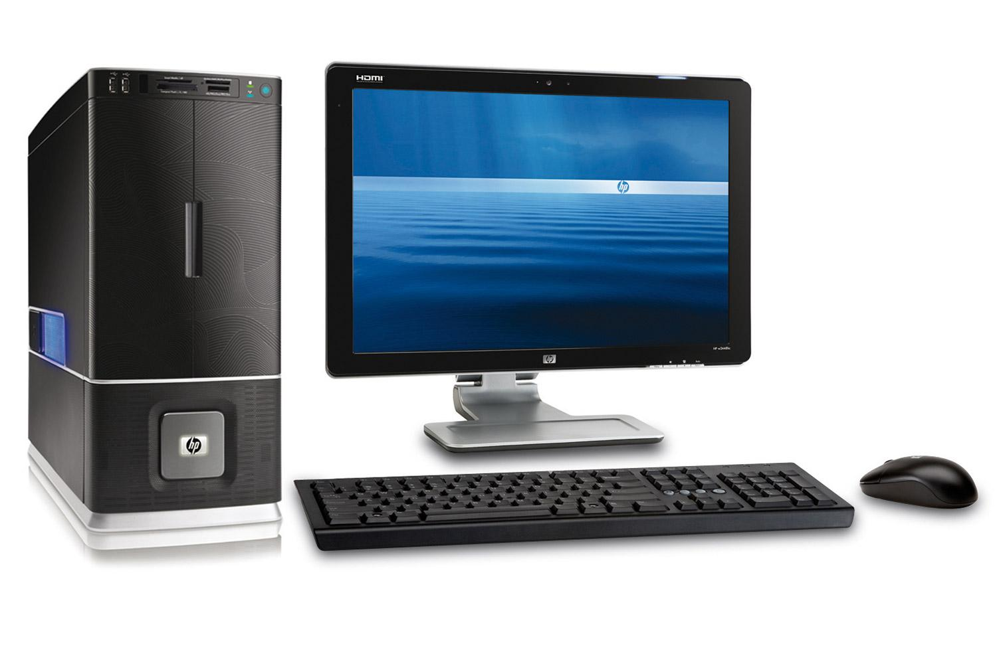


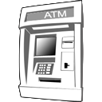

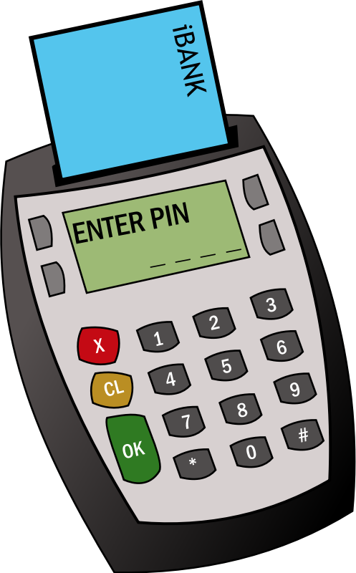
As pessoas deixam rasto digital em todo o lado
Ficheiros pessoais, histórico web, etc. são guardados no desktop, telefones, e serviços cloud como Dropbox
Ao logar-se em sites como o Gmail, o seu comportamento pode ser ligado ao seu nome real e endereço de email
Tudo que pesquisa na Web e compra em sites como a Amazon ou põe no Facebook fica gravado para sempre
Dispositivos móveis deixam rastos: as chamadas feitas, a localização, etc.
Câmaras de vigilância no metro e autocarros registam a sua entrada e saída nos transportes
…
É possível utilizer estes rastos digitais como prova em tribunal?

Slide 3
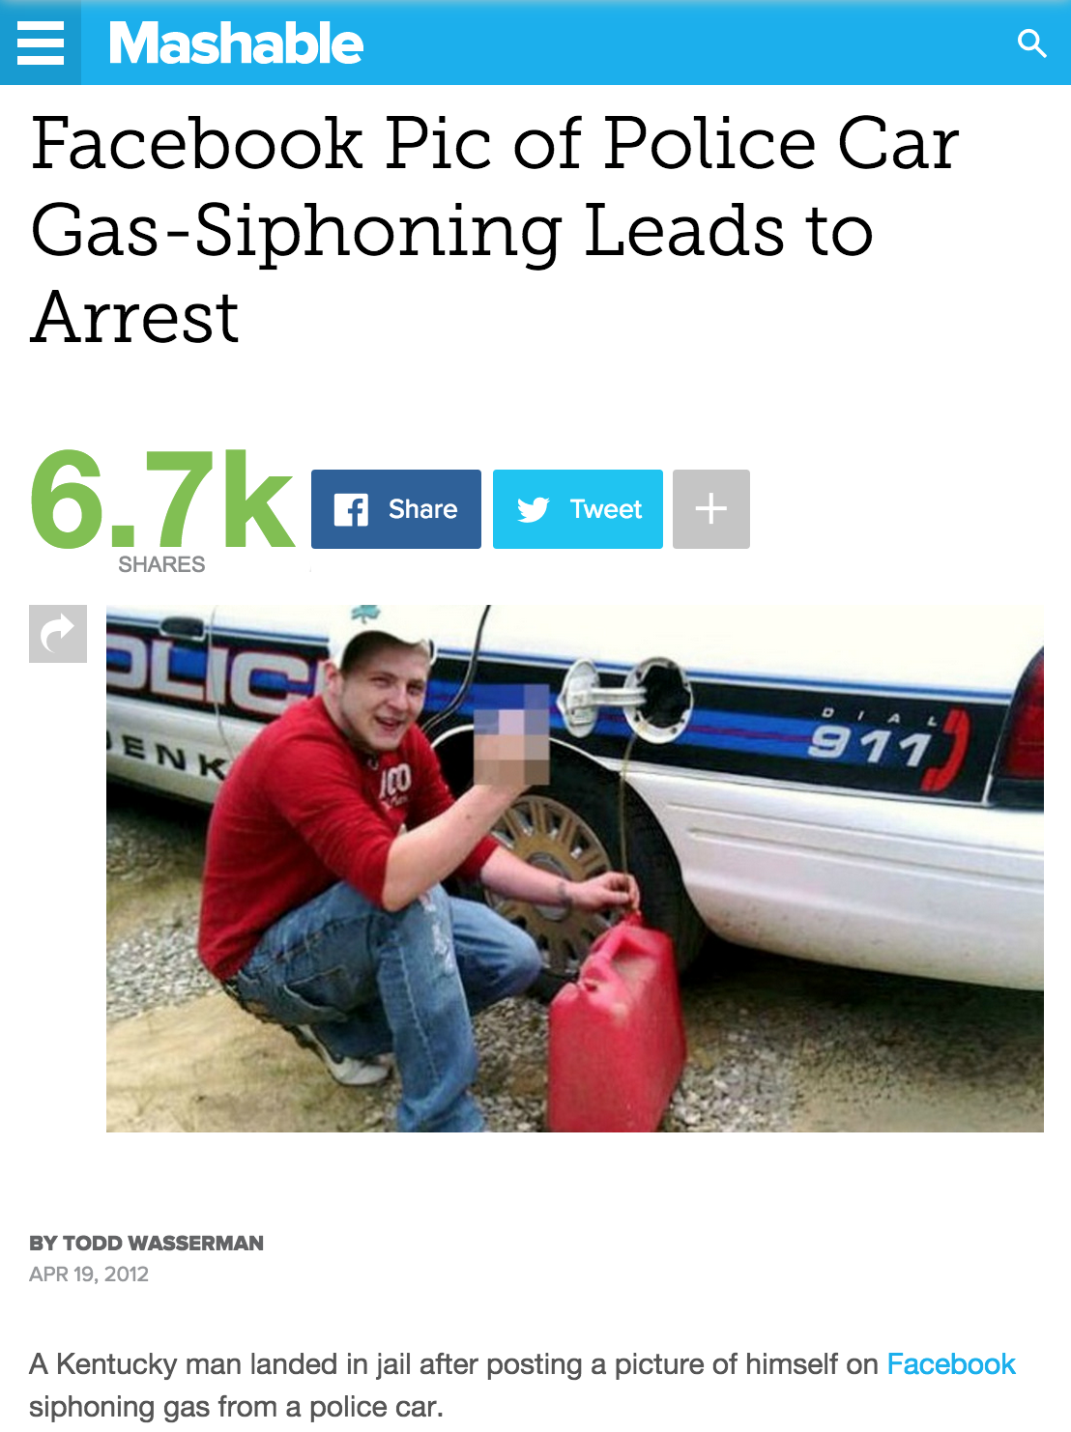
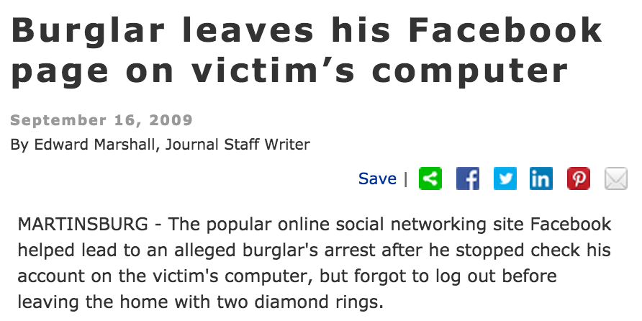
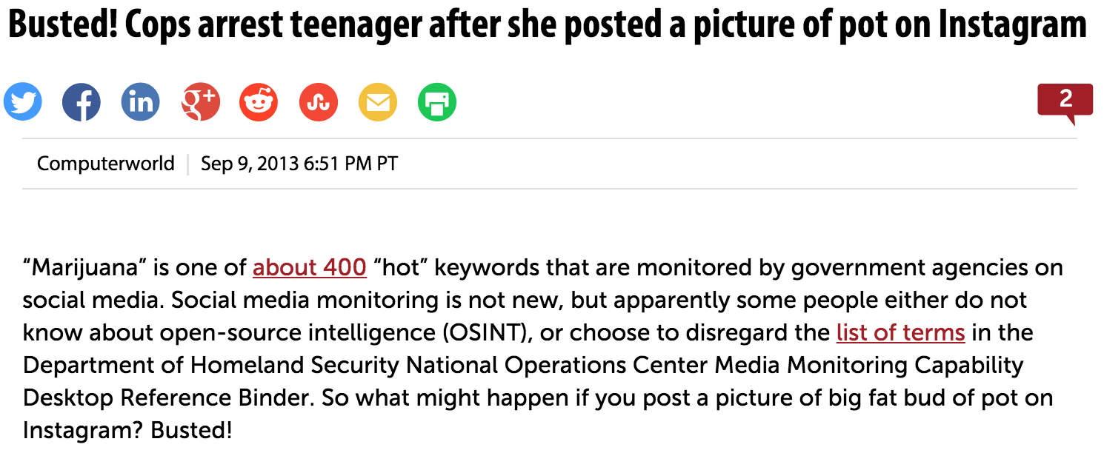
Sim!
Notes:
http://mashable.com/2012/04/19/facebook-police-gas-arrest/#3w2Hfkvkgmkn
http://www.computerworld.com/article/2474831/data-privacy/busted--cops-arrest-teenager-after-she-posted-a-picture-of-pot-on-instagram.html
http://www.journal-news.net/page/content.detail/id/525232.html

Slide 4

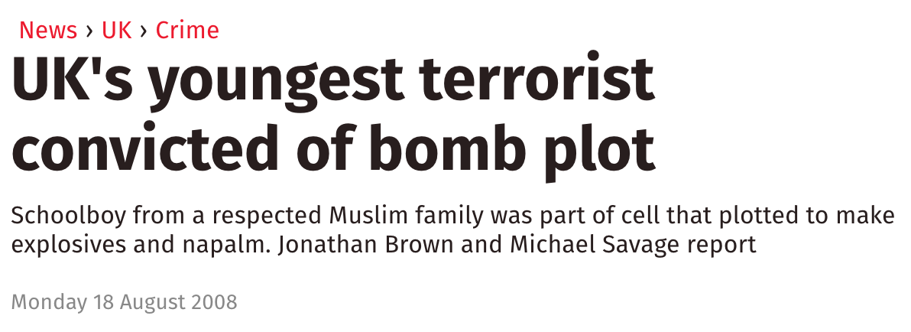
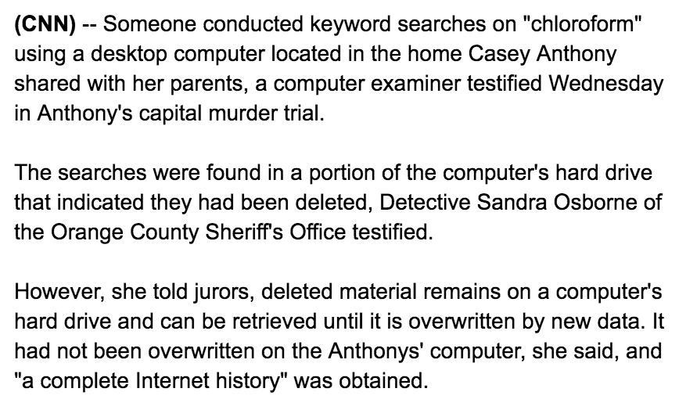
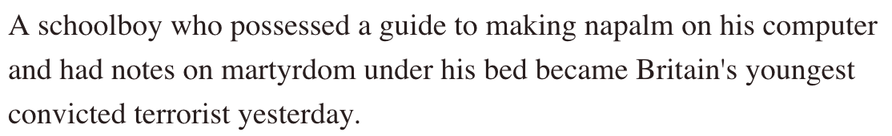
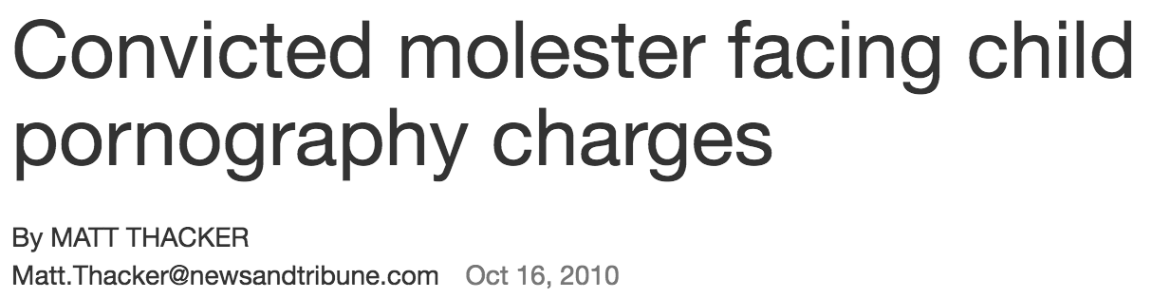
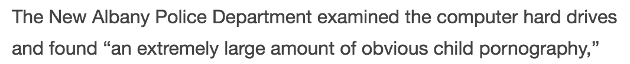
Exemplos (mais) sérios
Notes:
http://edition.cnn.com/2011/CRIME/06/08/florida.casey.anthony.trial/
http://www.independent.co.uk/news/uk/crime/uks-youngest-terrorist-convicted-of-bomb-plot-901863.html
http://www.newsandtribune.com/news/clark_county/convicted-molester-facing-child-pornography-charges/article_4ac3b417-9e90-577f-a259-af335451c70f.html

Slide 5



O que é segurança forense?
Segurança forense (AKA: ciber-segurança forense):
Ramo de ciência forense que se ocupa com a aquisição, preservação, e análise de prova digiral, tipicamente depois da ocorrência de acesso não autorizado
Incidente
reportado
Aqui começa o trabalho
do investigador forense
Rastos digitais
Tempo
Prova digital

Slide 6
O que é prova digital?
Prova digital: consiste em toda a informação de teor probatório armazenada ou transmitida em formato digital que possa ser usada em tribunal
Ex., emails, fotografias digitais, registos de transações ATM, bases de dados, backups, etc.
O objectivo da segurança forense consiste em explicar o estado actual de um determinado rasto digital

Slide 7
Casos de uso de segurança forense
Processos criminais
Baseiam-se em rastos obtidos a partir de um ou mais computadores para processar suspeitos e usar como prova
Litígios civis
Dados pessoais ou de empresas descobertos em computadores que podem ter sido usados em casos de fraude, divórcio, perseguição, ou discriminação
Companhias de seguros
Prova em computadores que pode ser utilizada para atenuar custos (fraude, compensação de trabalhadores, incendios, etc.)

Slide 8
Casos de uso de segurança forense
Empresas particulares
Para obter prova de computadores de empregados em casos de perseguição, fraude, extorsão, e corrupção
Agentes da lei (polícias)
Usam métodos de segurança forense para recolha de prova em buscas e tratamento / manuseamento de prova após apreensão
Individuos / investigadores privados
Obtençã de serviços por parte de analistas forenses profissionais para suportar alegações em casos de perseguição, abuso, ou despedimento indevido do emprego

Slide 9
Alguns casos muito mediáticos
The BTK Killer
From 1974 to 1991, 10 murders were committed in and around Wichita, Kansas, all by the same criminal dubbed the BTK Killer in the media. Although the killer communicated with police and media regularly, his identity remained a mystery, and investigators had given up hope of solving the case until he reinitiated contact in 2004. He delivered this message on a floppy disk, based on police "assurances" that documents saved on a floppy disk are not traceable. However, using metadata on a deleted Microsoft Word document, police were quickly able to trace BTK's true identity: Dennis Rader. Rader is now serving 10 consecutive life sentences in a Kansas prison. BTK's floppy disk error made his trial one of the most famous forensic cases ever.
The Corcoran Group
This lawsuit occurred over a fairly insignificant crime; plaintiffs claimed that defendants, including the real estate firm The Corcoran Group, knowingly sold them a condominium that flooded during storms, but failed to disclose this information to the buyers. The court discovered that the Corcoran Group defendants had deleted many emails relevant to the case once litigation began. This case changed the legal precedent on storage and deletion of electronically stored information, establishing an obligation to preserve electronically stored information relevant to a lawsuit that is underway or that seems likely to occur in the future.
Notes:
"BTK" stands for "Bind, Torture, Kill"
plaintiffs: queixoso
defendant: arguido

Slide 10
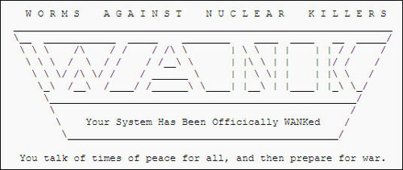
Exemplos de casos não resolvidos
The WANK Worm (1989)
Possibly the first “hacktivist” (hacking activist) attack, the WANK worm hit NASA offices in Greenbelt, Maryland. WANK (Worms Against Nuclear Killers) ran a banner (pictured) across system computers as part of a protest to stop the launch of the plutonium-fueled, Jupiter-bound Galileo probe. Cleaning up after the crack has been said to have cost NASA up to a half of a million dollars in time and resources. To this day, no one is quite sure where the attack originated, though many fingers have pointed to Melbourne, Australia-based hackers.
CD Universe Credit Card Breach (2000)
A blackmail scheme gone wrong, the posting of over 300,000 credit card numbers by hacker Maxim on a Web site entitled "The Maxus Credit Card Pipeline" has remained unsolved since early 2000. Maxim stole the credit card information by breaching CDUniverse.com; he or she then demanded $100,000 from the Web site in exchange for destroying the data. While Maxim is believed to be from Eastern Europe, the case remains as of yet unsolved.
Notes:
WANK: ataque aos escritórios da NASA
CD Universe: recusaram o resgate
http://www.ecommercetimes.com/story/2178.html
WannaCry
https://www.csoonline.com/article/3212260/ransomware/the-5-biggest-ransomware-attacks-of-the-last-5-years.html

Slide 11
Evolução temporal da segurança forense
70’s
Primeiros casos de crimes envolvendo computadores, sobretudo fraude financeira
80’s
FBI Computer Analysis and Response Team (CART) foi criada
90’s
International Organization on Computer Evidence (IOCE)
00’s
USA PATRIOT Act ("Computer Crime”) permitiu a agências governamentais grande liberdade em investigação forense para combate ao terrorismo
Casos tratados pelo FBI CART ultrapassam 6500 casos (782 TB de dados)
Em Portugal, Lei do Cibercrime (Lei nº 109/2009)
Notes:
The Computer Analysis and Response Team provides assistance to FBI field offices in the search and seizure of computer evidence as well as forensic examinations and technical support for FBI investigations. This Unit includes a state-of-the-art forensic laboratory comprised of computer specialists and a network of trained and equipped forensic examiners assigned to more than 50 field offices.
In 1999, at the request of the Group of Eight (G8), the International Organization on Computer Evidence (IOCE), which is no longer a functioning organization, with SWGDE contributions, authored a set of principles and definitions that the group felt were as close to universal as possible. These principles were published in the Forensic Science Communications journal and submitted to the G8; the principles were adopted by the G8 in 2001.

Slide 12
Ramos (não oficiais) da segurança forense
Computer forensics
Flash, HDD, dispositivos USB
Network forensics
Monitorização e análise de tráfego de rede
Mobile device forensics
Obtenção de prova de dispositivos móveis
Cloud forensics
Análise forense de infrastruturas de núvem
…
Segurança
Forense

Slide 13

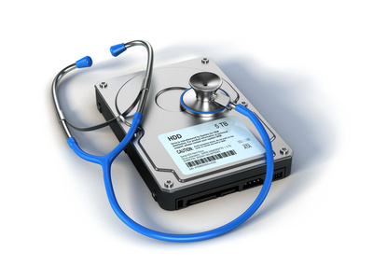
Segurança forense vs. outras disciplinas
Segurança de computadores debruça-se sobretudo com prevenção de acesso não autorizado, bem como a manutenção de confiabilidade, integridade, e disponibilidade de sistemas de computadores
Recuperação de dados é o processo de recuperar dados inacessíveis a partir de sistemas de computadores corrompidos ou danificados não necessariamente no âmbito de uma investigação digital

Slide 14
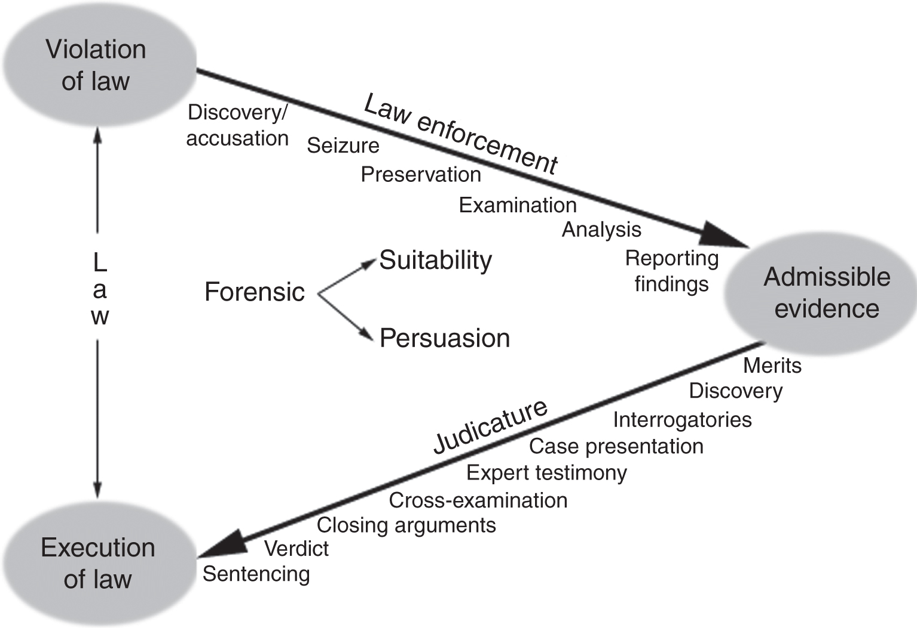
Ciclo de vida da segurança forense
Processo de resolução de um caso / incidente
Início

Slide 15
Admissibilidade de prova e modelo de investigação

Slide 16
Admissibility of digital evidence

Slide 17
Only admissible evidence be accepted in court
What makes evidence “admissible”?
Short answer – if a judge says it is, it is…
Judges use guidelines for admissibility:
Is the evidence relevant?
Is the evidence authentic?
Is the evidence credible?
Was the evidence collected legally?
An overriding principle is the “exclusionary rule” which says it is not admissible if these criteria are not met
Notes:
Exclusionary = excludente

Slide 18
Is it relevant?
The question of relevance is usually the first considered by a judge: If it is not relevant, then it will not be admissible
To be deemed relevant, evidence must satisfy 2 conditions:
It must be material – directly relating to the case being presented
It must be probative – proves something that will help get to the truth of the situation
Example:
In US vs. Carey (1998), the investigator found child pornography on a machine while searching for evidence on drug-related activity but the images were inadmissible because they were outside the scope of the warrant

Slide 19
Is it authentic?
The question of authenticity is basically asking if the evidence is what it purports to be
This requires asking a number of questions which include:
Was it collected correctly?
Could it have been altered in any way?
Must show that:
Evidence was acquired from a specific computer and / or location
A complete and accurate copy of digital evidence was acquired
Evidence remained unchanged since it was collected

Slide 20
Is it credible?
This requires asking a number of questions which include:
Is the material an opinion (hearsay)?
Is the evidence sustained by the testimony of an expert witness?
Knowledge from secondary sources is ‘hearsay evidence’ and is, in principle, inadmissible
I.e., not what the witness knows personally, but what someone else told him or her
For instance: an e-mail message may be used to prove that an individual made certain statements, but cannot be used to prove the truth of the statements it contains
Larry Froistad sent a message to an e-mail list saying he had killed his daughter, but a confession and other evidence were needed
Notes:
Hearsay: rumores, boatos

Slide 21
Exceptions to the hearsay rule
Business records
Documents compiled by the ordinary course of a business (e.g., emails, records, memoranda, etc.)
Were supplied by a person who had personal knowledge of the matters dealt with
When a person is not involved, namely computer-generated data
A person is not making an assertion
E.g., logs, network traces, etc.

Slide 22
Reporting certainty
Certainty Level | Description/Indicators | Commensurate Qualification
C0 | Evidence contradicts known facts | Erroneous/incorrect
C1 | Evidence is highly questionable | Highly uncertain
C2 | Only one source of evidence is not protected against tampering | Somewhat uncertain
C3 | The source(s) of evidence are more difficult to tamper with but there is not enough evidence to support a firm conclusion or there are unexplained inconsistencies in the available evidence | Possible
C4 | (a) Evidence is protected against tampering or (b) evidence is not protected against tampering but multiple, independent sources of evidence agree | Probable
C5 | Agreement of evidence from multiple, independent sources that are protected against tampering. However, small uncertainties exist (e.g., temporal error and data loss) | Almost certain
C6 | The evidence is tamperproof or has a high Statistical confidence | Certain

Slide 23
Examples of certainty assessment
C6:
Files containing known child pornography were found on the defendant’s computer, on the basis of hash values of the files matching known child pornography and a visual inspection of the file contents
C4:
Multiple items of evidence on the defendant’s computer link him to the identity theft targeting the victim, including e-mail on May 31, 2010, confirming a Visa credit card in the victim’s name, USBank online loan application completed in victim’s name, and a cash advance on a MasterCard credit card in the victim’s name
C0:
The conclusion that Julie Amero intentionally accessed pornography Web sites while in the classroom is contradicted by evidence that pornographic pop-ups appearing on the computer were the result of an automated “spyware” program on the computer

Slide 24
Was evidence obtained legally?
Search warrants are required
The most common mistake that prevents digital evidence from being admitted by courts is that it is obtained without authorization
Privacy violations render evidence inadmissible
Directives for data privacy protection defined by law
EU: Framework Decision 2005/222/JHA on attacks against information systems
Portugal: Lei do Cibercrime
USA: First and fourth amendments to the U.S. Constitution

Slide 25
European law
Council of Europe (CoE) legislation (47 Members)
The Convention on Cybercrime (CETS 185)
Cybercrime Convention on racism through computer systems (CETS 189)
Protection of children against sexual abuse (CETS 201)
EU legislation (28 Members)
Framework Decision 2005/222/JHA on attacks against information systems (Lisbon treaty)
PT legislation
Lei 109/2009 – Lei do cibercrime
Transposition of Framework decision
Notes:
Council of Europe Treaty Series (Conselho da Europa) e comissão europeia
The Council of Europe (CoE; French: Conseil de l'Europe), founded in 1949, is a regional intergovernmental organisation which promotes human rights, democracy and the rule of law in its 47 member states, covering 820 million citizens.
The Council of Europe (CoE; French: Conseil de l'Europe) is an international organisation focused on promoting human rights, democracy and the rule of law in Europe. Founded in 1949, it has 47 member states, covers approximately 820 million people and operates with an annual budget of approximately half a billion euros.[2]
The organisation is distinct from the 28-nation European Union (EU), although it is sometimes confused with it, partly because the EU has adopted the original European Flag which was created by the Council of Europe in 1955,[3] as well as the European Anthem.[4] No country has ever joined the EU without first belonging to the Council of Europe.[5]
Unlike the EU, the Council of Europe cannot make binding laws, but it does have the power to enforce select international agreements reached by European states on various topics. The best known body of the Council of Europe is the European Court of Human Rights, which enforces the European Convention on Human Rights.

Slide 26
Lei do Cibercrime
Lei n.º 109/2009, de 15 de Setembro
CAPÍTULO III: Disposições processuais
Artigo 12.º: Preservação expedita de dados
Artigo 13.º: Revelação expedita de dados de tráfego
Artigo 15.º: Pesquisa de dados informáticos
Artigo 16.º: Apreensão de dados informáticos
Artigo 17.º: Apreensão de correio electrónico e registos de comunicações de natureza semelhante
Notes:
http://www.anacom.pt/render.jsp?contentId=985560#.V_Kb-JMrI7x

Slide 27
EU’s Data Protection Directive
Everyone has the right to the protection of personal data.
Under EU law, personal data can only be gathered legally under strict conditions, for a legitimate purpose. Furthermore, persons or organisations which collect and manage your personal information must protect it from misuse and must respect certain rights of the data owners which are guaranteed by EU law.
Every day within the EU, businesses, public authorities and individuals transfer vast amounts of personal data across borders. Conflicting data protection rules in different countries would disrupt international exchanges. Individuals might also be unwilling to transfer personal data abroad if they were uncertain about the level of protection in other countries.
Therefore, common EU rules have been established to ensure that your personal data enjoys a high standard of protection everywhere in the EU. You have the right to complain and obtain redress if your data is misused anywhere within the EU
http://ec.europa.eu/justice/data-protection/
Notes:
Data Protection Directive - 95/46/EC http://europa.eu.int/comm/internal_market/privacy/index_en.htm
Had to be transposed into national law by 24 October 1998
Directive 97/66/EC – Protection of privacy in telecommunications
Listening, tapping, storage, interception, surveillance…
http://ec.europa.eu/justice/data-protection/

Slide 28
Privacy in USA
First amendment to the U.S. Constitution: Protects speech and religion from government interference
Fourth amendment: protects citizens from unreasonable search and seizure

Slide 29
4th Amendment when acquiring evidence
When does evidence “seizure” occur?
Who owns the computer that contains data?
What type of image is “good enough” to be searched?
Do attempts to delete data involve privacy or indicate a cover-up?
When searching a network, where do you stop?
What if one search leads to another? Where does one search stop and another begin?

Slide 30
After Sept. 11, 2001, the USA PATRIOT Act¹
Greatly broadened FBI’s authority to gather electronic evidence
Allows:
Intercept voice communications in computer hacking cases
Trace communications on the Internet
Subpoena for cable company records
Intercept communications of computer trespassers
ISPs can disclose content and non-content information in emergency situations
Nationwide search warrants for e-mail
“Sneak & Peek” – Permits investigator to delay notification of “search”
Establishment of Regional Computer Forensic laboratories
¹ Uniting and Strengthening America by Providing Appropriate Tools Required to Intercept and
Obstruct Terrorism
Notes:
Act of Congress that was signed into law by President George W. Bush on October 26, 2001.

Slide 31
Processo de investigação digital

Slide 32
What is the goal of a digital investigation?
To uncover the truth by producing admissible evidence
To be admissible, evidence must meet the following criteria:
Relevance: be related to the case and prove something
Authenticity: evidence is the same as the originally seized
Credibility: the original evidence or admissible hearsay
Legality: search and seizure are authorized and privacy is assured
Ultimately, the judge decides, but the digital investigator is responsible for ensuring all these criteria are met

Slide 33
Path to producing admissible evidence
Case / incident resolution process

Slide 34
Digital investigation model
Predefined pattern of activities when performing an investigation to generate admissible evidence
Serve as useful points of reference for reflecting on the state and nature of the field
Independent of a particular technology in corporate, military, and law enforcement environments
In short: models encourage a complete, rigorous investigation, ensures proper evidence handling, and reduce the chance of mistakes created by preconceived theories, time pressures, etc.

Slide 35
First reference model for digital forensics
Kruse & Heiser model (2001) – comprises four steps:
1.
Assessment
(Avaliação)
2.
Acquisition
(Apreensão)
3.
Analysis
(Análise)
4.
Reporting
(Apresentação)
Prepare plan of action, and find potential sources of digital evidence
Prevent changes of in situ digital evidence and collects them
Search for and interpret evidence trace in order to reconstruct the crime scene
Reporting of findings in a manner which satisfies the context of the investigation

Slide 36
1. Assessment
First steps:
Define the scope and likely venue of the examination
Collect all legal documentation needed
Get any permissions for resources not covered by warrants
Determine likely sources of evidence for the case
Sources of data are reliable
Notes:
In other words, determine the “lay of the land” of the case. Prior to accepting the case, you need to decide if you are qualified to handle it (scope and examination expertise).

Slide 37
Authorization level set by the investigation type
Internal investigations
Sponsored by an organization. They generally start out as a deep, dark secret that the company doesn’t want getting out. Courts rarely involved at the outset (e.g., insider suspicious activity)
Civil investigations
Require involvement of courts. The plaintiff and the defendant are two litigants asking the courts to settle a dispute (e.g., patent-related dispute)
Criminal investigations
Involve the courts. The defendant is the person accused of a crime and the plaintiff is the one making the accusation, which will always be some level of government authority (e.g., homicide case)
Notes:
Defendant: arguido
Plaintiff: queixoso

Slide 38
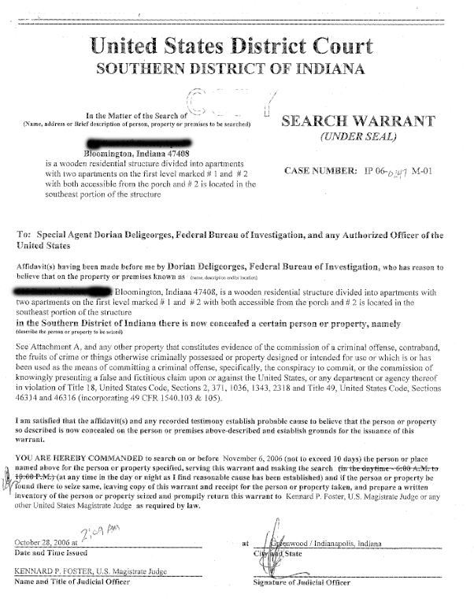
Required authorization levels
For internal investigations
You need a signed letter of agreement outlining the scope of the investigation along with contractual details
For civil and investigations
You need a court order prior to starting
Notes:
If you are working a criminal case, you will most likely have been hired by a government agency. They will have their own processes and procedures to adhere to in addition to the legal documents mentioned in the slide.
As a general rule, always assume that the case will go to trial. That way you will have all the needed documentation and procedures in place to build a strong case.
http://jasminpkwildon.blogspot.pt/2010/05/search-warrant.html

Slide 39
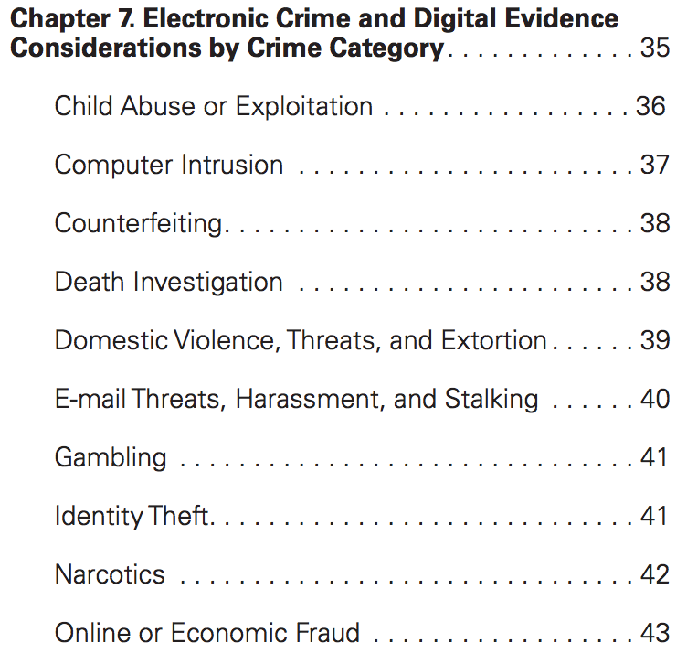
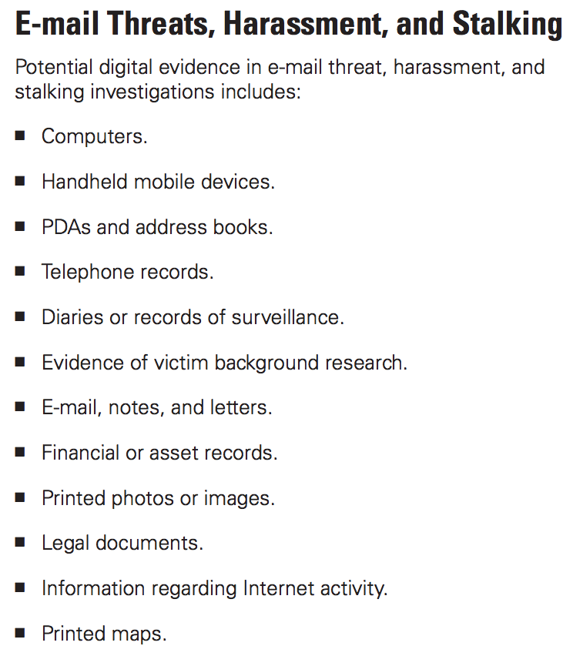
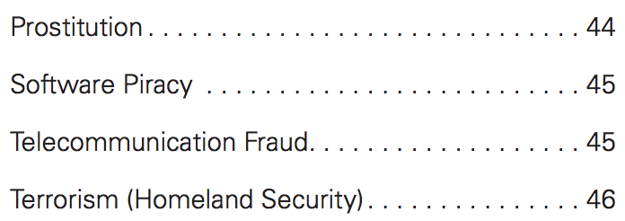
Identification of sources of evidence
General hint: Follow the data path
Depends on the kind of case or crime category
E.g., recommendations from [NIJ04]:
Notes:
US. Deparment of Justice, National Institute of Justice

Slide 40
Additional steps in assessment stage
Identify the forensic tools required
Evidence to be collected w/ court-recognized dependable tools
Identify the personnel needed
Personnel must be qualified to do their jobs
Identify the stakeholders

Slide 41
2. Acquisition
Evidence collection methods must assure that:
All issues of legal “search & seizure” are followed
Evidence integrity was preserved upon extraction
Evidence presented to the court is authentic
Evidence collection is as complete as possible

Slide 42
Maintaining chain of custody
Maintain a chain of custody, a.k.a continuity of possession:
One of the most important aspects of authentication is maintaining and documenting the chain of custody of evidence
Begins when evidentiary materials are first seized
Time and date taken
From whom and where
Complete description of each item
Every time an item changes hands, time, date and people involved (get signatures)

Slide 43
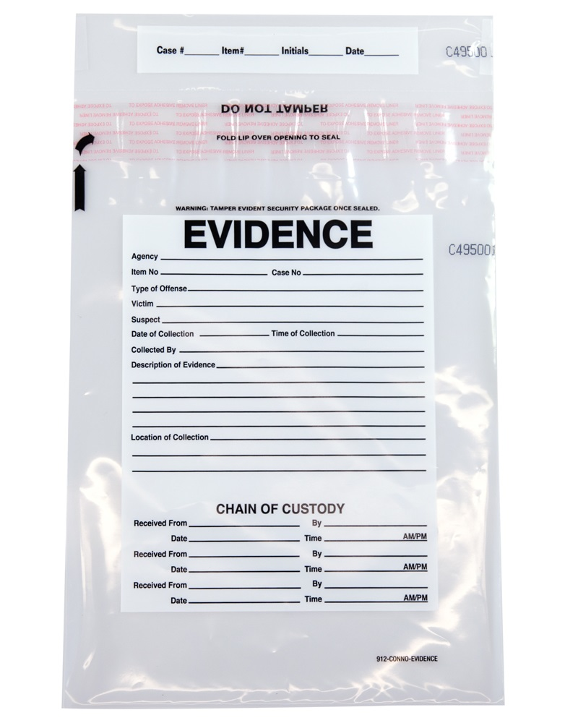
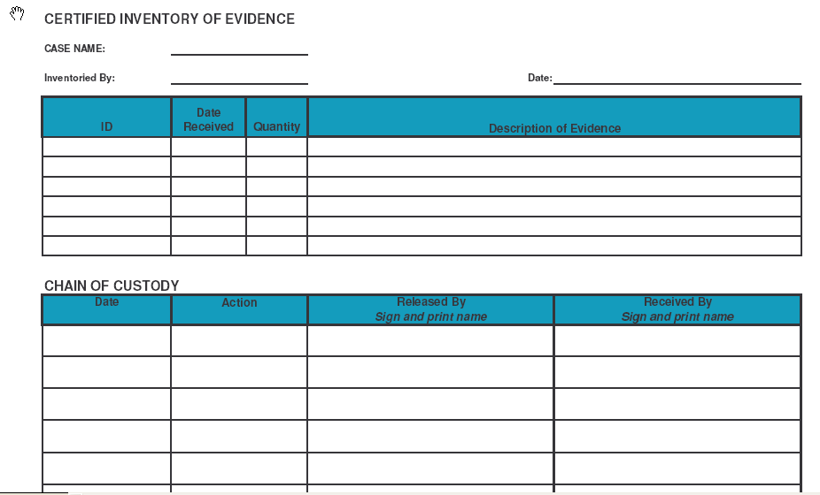
Chain of custody form
Example of a chain of custody form:

Slide 44
Potential issues with the chain of custody
Incomplete: gaps
Inconsistent dates
Lacking custodians’ signatures or identification
Custodian is not competent or authorized

Slide 45
Importance of the chain of custody
Chain of custody: there can be no gaps in history!
Case law: The value of the chain of custody
It is inevitably a good idea to present a flawless chain of custody in order to avoid having evidence declared inadmissible. “Missing links” in the chain: “When a ‘vital link’ in the possession and treatment of the evidence is left to conjecture, the chain of custody is incomplete, and the evidence is inadmissible” (Jeter v. Commonwealth 05).
Conversely, in Hargrove v. Commonwealth, Justice Felton wrote, “It concluded that because the evidence container was received at the lab ‘sealed and intact,’ there was no evidence that it was subject to tampering between the time it left the police evidence room and the time that it was removed from the lab storage locker. We conclude that the trial court did not err in admitting the evidence container and the certificate of its analysis” (Hargrove v. Commonwealth 09).

Slide 46
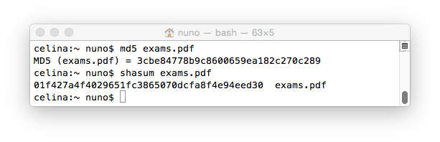
Integrity checks
Integrity checks aim to show that evidence has not been altered from the time it was collected, thus supporting the authentication process
Verifying the integrity of evidence generally involves a comparison of the digital fingerprint for that evidence taken at the time of collection with the digital fingerprint of the evidence in its current state
A digital fingerprint is produced by a message digest algorithm, e.g., MD5, or SHA-1

Slide 47
Generation of integrity checks
A message digest algorithm (hash function) can be seen as a black box that:
It has two important properties:
Always produces the same number for a given input
It will produce a different number for different inputs
digital object
MD5
input
digest
output

Slide 48
Why hash functions work well
Therefore, an exact copy will have the same message digest as the original but if a file is changed even slightly it will have a different message digest from the original
Most commonly used cryptographic hash functions:
MD5: produces as output a128-bit hash value (“fingerprint”)
SHA-1: produces a 160-bit (20-byte) hash value
Digital input | MD5 output
The suspect’s name is John | 0dc789ca62a3799abca7f1199f7c6d8c
The suspect’s name is Joan | d5b5034d2f3bd578a136e18946e5777a

Slide 49

Integrity check generation using MD5
The word fingerprint emphasizes the near uniqueness of a message digest calculated using a digest algorithm
Therefore, authenticate that the copy is identical to the original (i.e., hash values). Make a 2nd copy.
File 1
MD5
Digest1
P (two files w/
equal hashes) =
File 1
(copy)
1300 < probable than
wining the EuroMillion
twice in a row
File 2
Digest2

Slide 50
Alternative integrity check methods
Integrity check method | Description | Common Types | Advantages | Disadvantages
Checksum | Method for checking for errors in digital data. Uses 16- or 32-bit polynomial to compute 16 or 32 bit integer result. | CRC-16 CRC-32 | Easy to compute Fast Small data storage Useful for detecting random errors | Low assurance against malicious attack Simple to create data with matching checksum
One-Way Hash | Method for protecting data against unauthorized change. Produces fixed length large integer (80~240 bits) representing digital data. Implements one-way function. | SHA-1 MD5 MD4 MD2 | Easy to compute Can detect both random errors and malicious alterations | Must maintain secure storage of hash values Does not bind identity with data Does not bind time with data
Digital Signature | Secure method for binding identity of signer with digital data integrity methods such as one-way hash values. Uses public key crypto system. | RSA DSA PGP | Binds identity to integrity operation Prevents unauthorized regeneration of signature | Slow Must protect private key Does not bind time with data

Slide 51
Handling digital evidence
Handle the digital evidence properly (more next class)
Other than in exceptional situations, never work on original data sources: create a copy of the original data
In a “live acquisition”, use proper procedures to capture data on-site: live forensics vs. post mortem analysis
Store the original and the 2nd copy (or other collected evidence) in a secure location where you can control access
Document all steps taken to collect the devices from the initial contact through arrival at the forensic lab

Slide 52
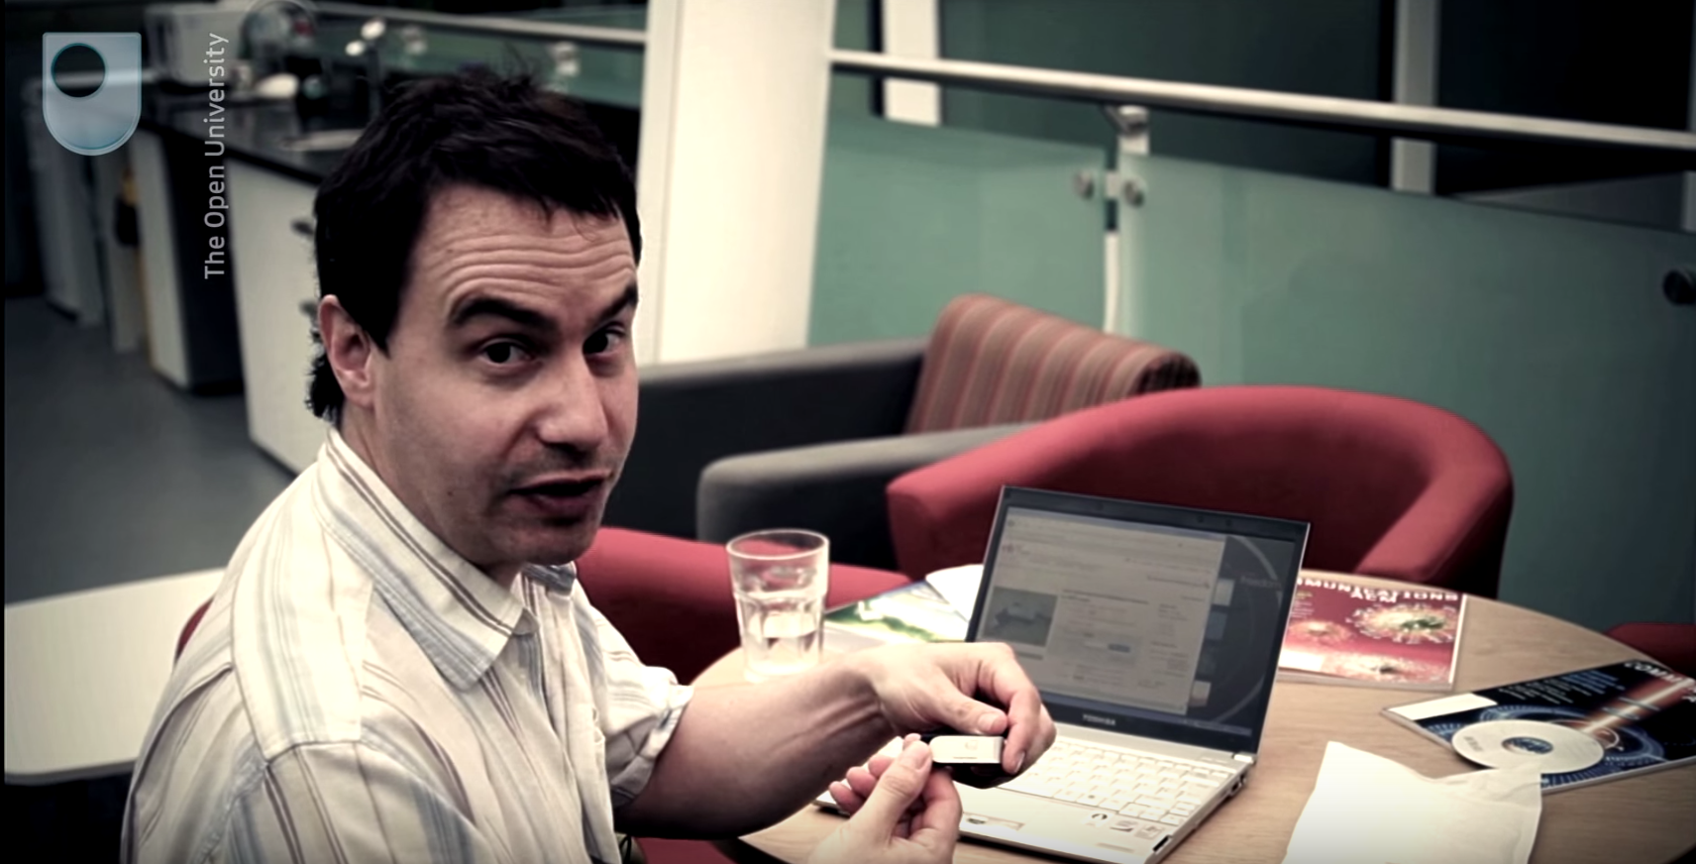
Use an imaging tool
Let’s create an image of the memory stick so that we can inspect its content while preserving integrity.
Extract the data using an imaging tool, e.g., dd
Mount the pen drive read only on forensics station
Use dd to create file containing bitwise image of volume
Compute MD5 of the image file
Create duplicate of the image file and check MD5
Preserve both copies on reliable and access controlled computers

Slide 53
3. Analysis
Using whatever forensic tools you deem necessary, locate and extract all material evidence, both:
Inculpatory: evidence that supports a given theory
Exculpatory: evidence that contradicts a given theory
Use court recognized tools and document everything

Slide 54
Examine existing artifacts looking for evidence
Overt evidence
Look through your data image for overt evidence. For example, pictures, documents, spreadsheets, etc. that could be evidence
Hidden evidence
Look for evidence that the system may have hidden
Deleted evidence
Look for evidence that the user may have deleted, but is still recoverable
Anti-forensic trails
Look for evidence of anti-forensic techniques being employed. E.g., encryption, ADS, hidden partitions, etc.

Slide 55
Connect the dots
Then, apply the scientific method and critical thinking to address the fundamental questions in an investigation: who, what, where, when, how, &why
Based on your knowledge of the case, decide what evidence is material to the case
Document all your findings as you go so that you can write your final report easier
Analyzing digital evidence aims to help investigators reconstruct an offense and assess the strength of the conclusions

Slide 56
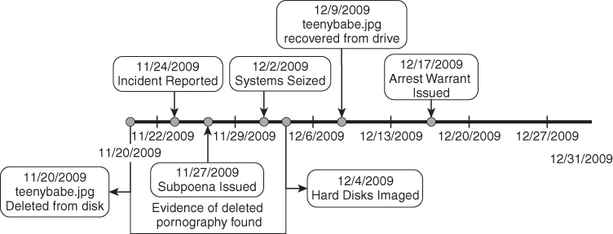
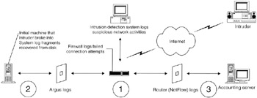
Forms of offense reconstitution
Temporal (when)
Helps identify sequences and patterns in time of events
Relational (who, what, where):
Components of crime, their positions and interactions
Functional (how)
What was possible and impossible (e.g., check if a suspect’s computer as capable of downloading and displaying the graph files presented as incriminating evidence)
Assuming that evidence has been preserved in forensically sound manner
Timeline reconstruction
Relational reconstruction
Notes:
[Casey11] Sec 8.1

Slide 57

4. Reporting
The work product of your analysis is the documentation
Without good documentation, you can’t present a robust case
Must be such that it allows for the reproducibility of findings
5 levels of documentation are needed:
General case documentation
Procedural documentation
Process documentation
Case timeline
Evidence chain of custody (already covered)

Slide 58
Levels of collected documentation
General case documentation
Contact information for everyone involved, all legal authorizations
First response documentation: notes, photographs, videos, etc.
Procedural documentation
Every task that was performed related to the investigation, list of equipment seized, steps taken and tools used, detailed data analysis
Process documentation
User manuals, installation manuals, update history logs, results of testing, README logs
Case timeline
Systematic analysis of what transpired, times and dates of related events

Slide 59
Producing the final report
Using the detailed documentation that you have collected:
Begin writing the report in a standard format appropriate for the audience
Fully explain all evidence that was retrieved
Fully explain any problems or discrepancies encountered during your analysis
Do not make any assertions of innocence or guilt; just present the facts as you found them

Slide 60

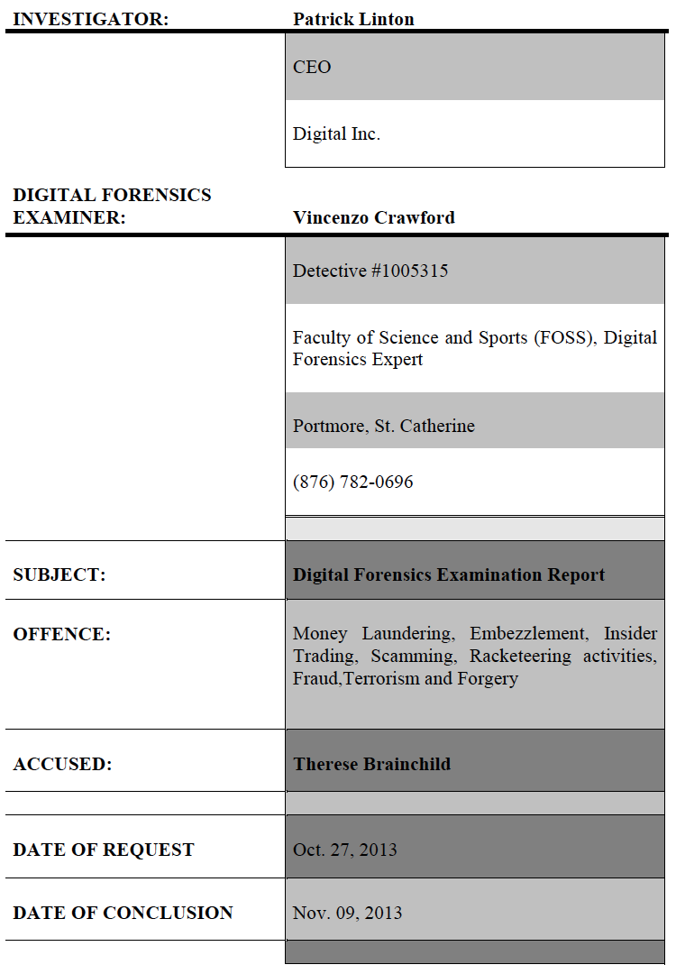
Example of a final report [Crawford15]

Slide 61
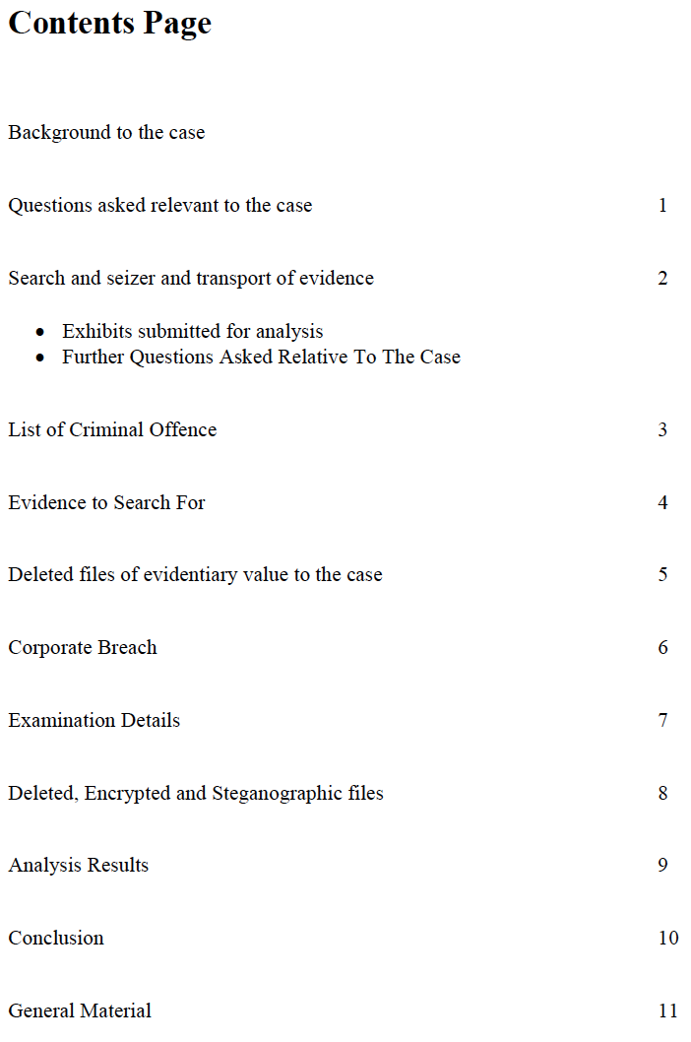
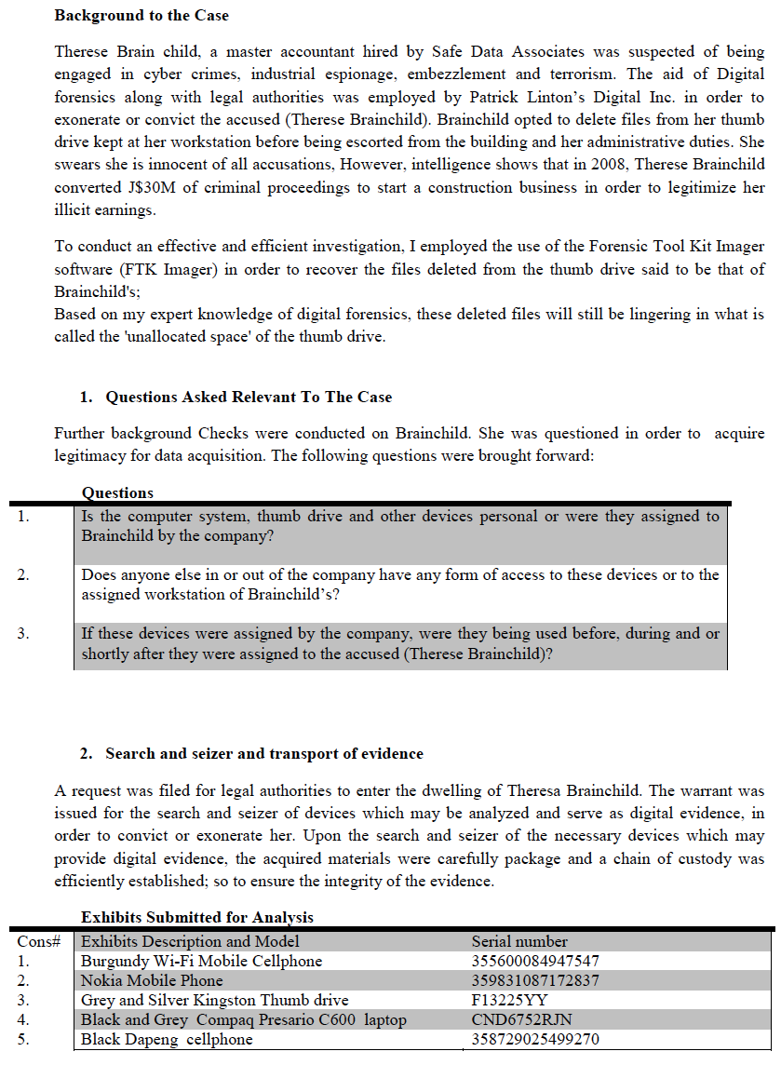
Notes:
Embezzlement: desvio de fundos

Slide 62
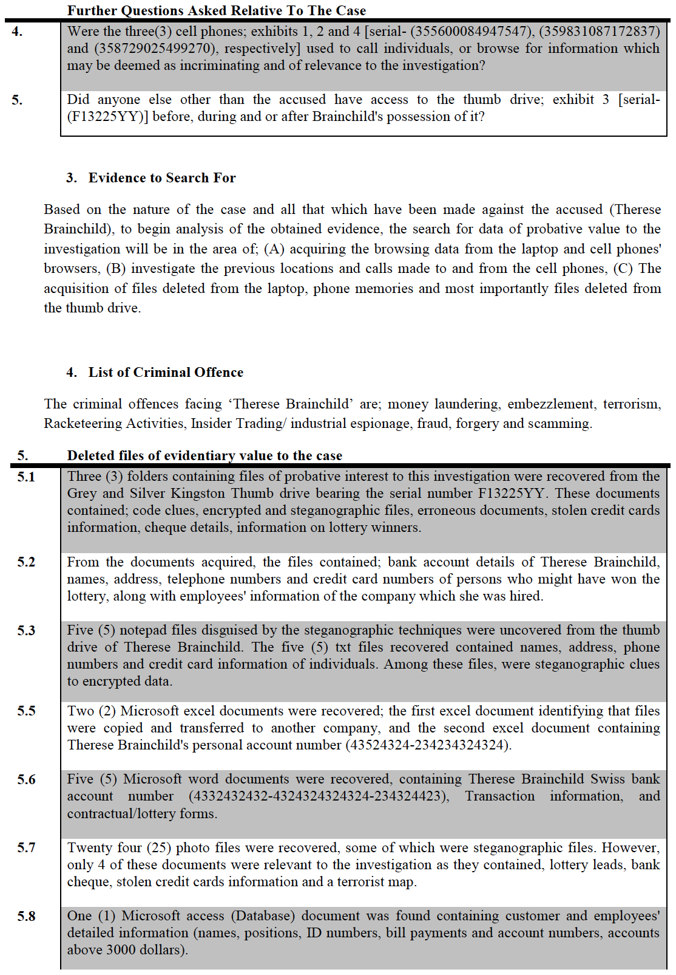
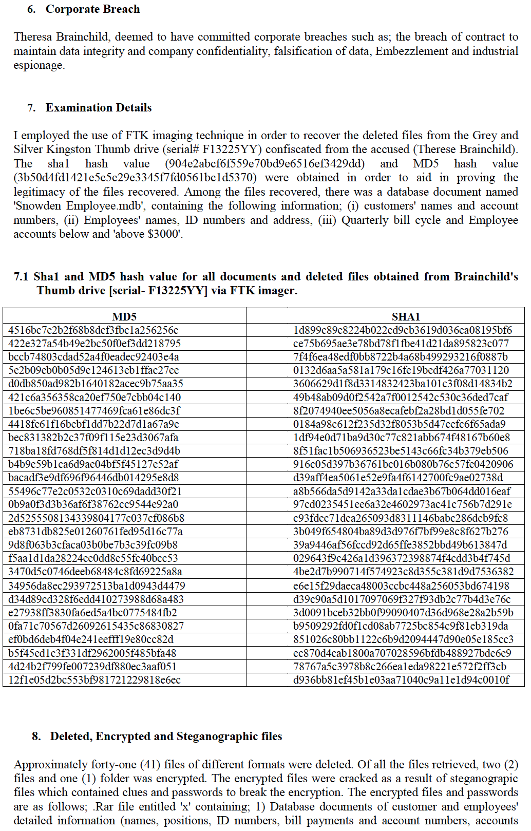

Slide 63
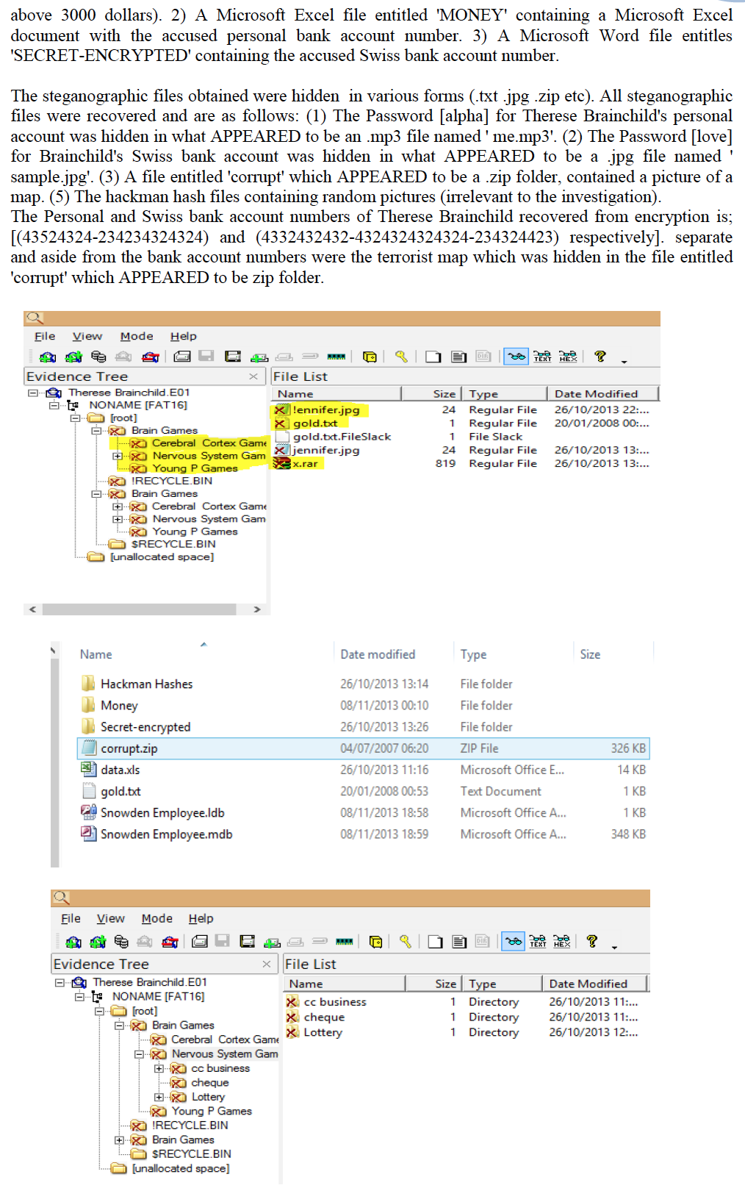
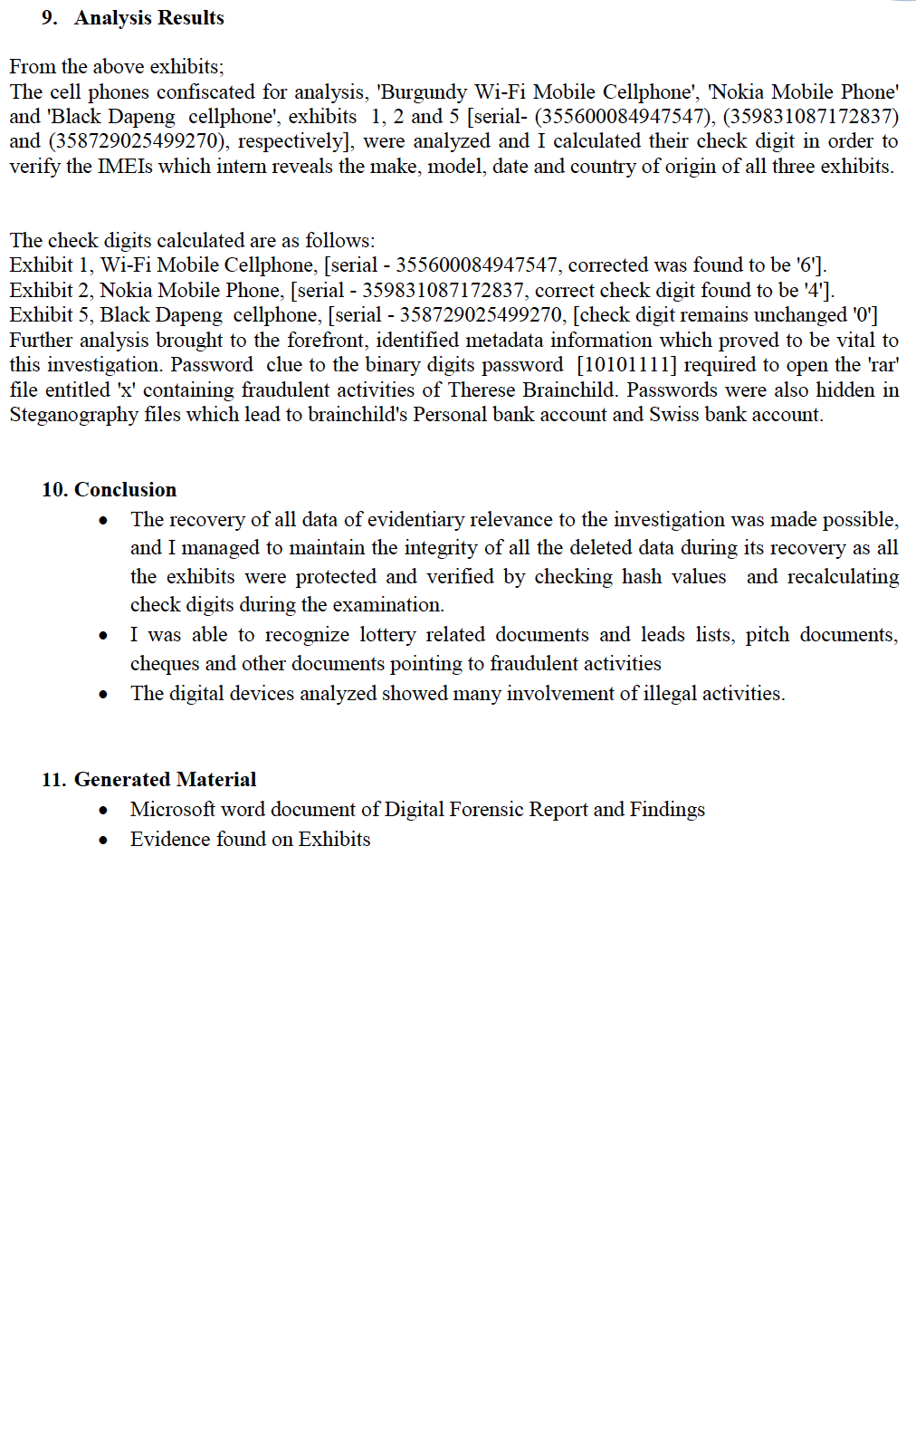

Slide 64
Alternative process models
The Casey 2001 model expands the previous model to 6 steps:
Identification / assessment
Collection / acquisition
Preservation
Examination
Analysis
Reporting
Main differences:
Emphasizes the importance (and process) of preserving the data
Distinguishes between the process of examination and analysis, whereas Kruse considered them to be two parts of a single process
Assessment
Acquisition
Analysis
Reporting
Kruse Model

Slide 65
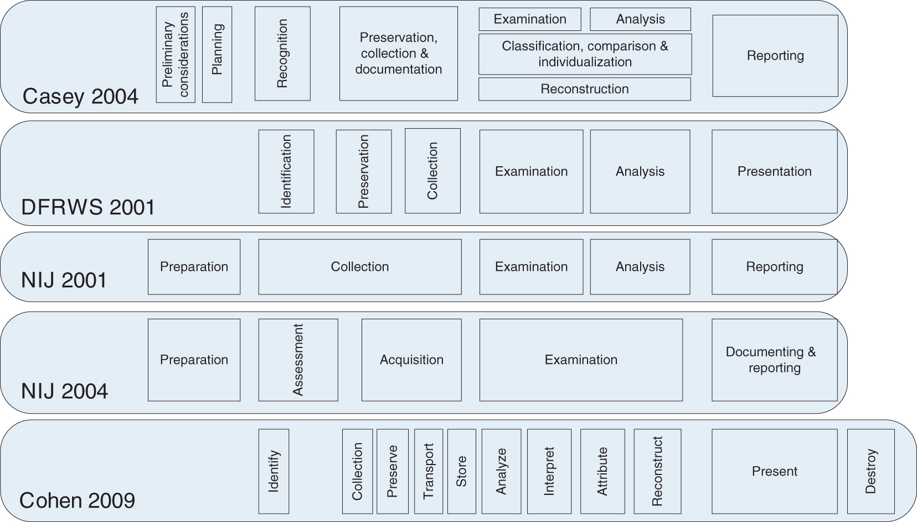
Many more models proposed
In general, end up being very complex and subtle

Slide 66
Some limitations of process models
Complexity
Define many steps and cumbersome inter-relations
Rigidness
In practice, most digital investigations do not proceed in linear fashion
Incompleteness
Don’t help digital investigators with some of the most important steps of each step of an investigation, including the completeness and repeatability of each step
Notes:
The process of obtaining reliable results in each step is not addressed directly in many of these investigative process models. The tenets of completeness, repeatability, and reliability apply to all aspects of a digital investigation, and not just to the forensic analysis steps

Slide 67
Common principles across investigation models
Principle 1 – Integrity
No action taken by law enforcement agencies, persons employed within those agencies or their agents should change data which may subsequently be relied upon in court
Principle 2 – Competence
In circumstances where a person finds it necessary to access original data, that person must be competent to do so and be able to give evidence explaining the relevance and the implications of their actions
Principle 3 – Auditability
An audit trail or other record of all processes applied to digital evidence should be created and preserved; an independent third party should be able to examine those processes and achieve the same result
Principle 4 – Responsibility
The person in charge of the investigation has overall responsibility for ensuring that the law and these principles are adhered to
Notes:
http://www.digital-detective.net/digital-forensics-documents/ACPO_Good_Practice_Guide_for_Digital_Evidence_v5.pdf

Slide 68
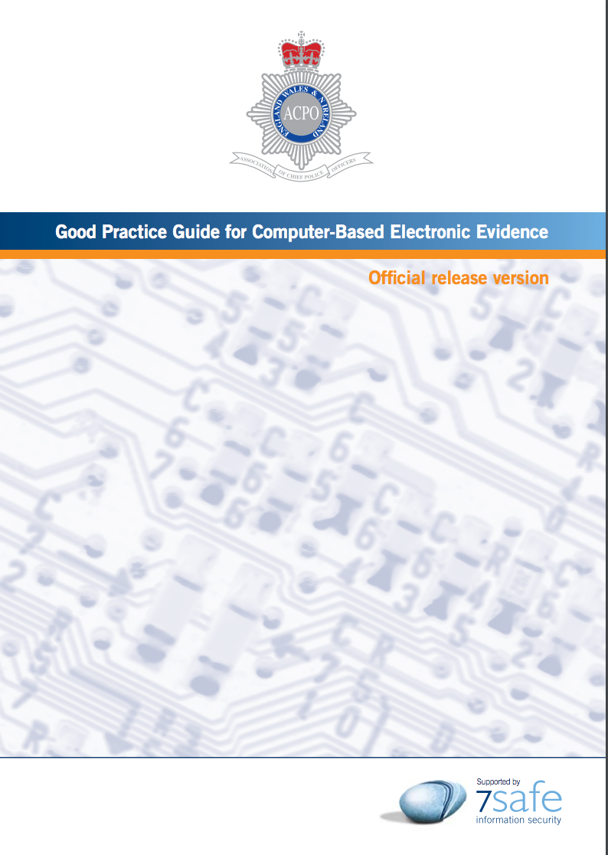
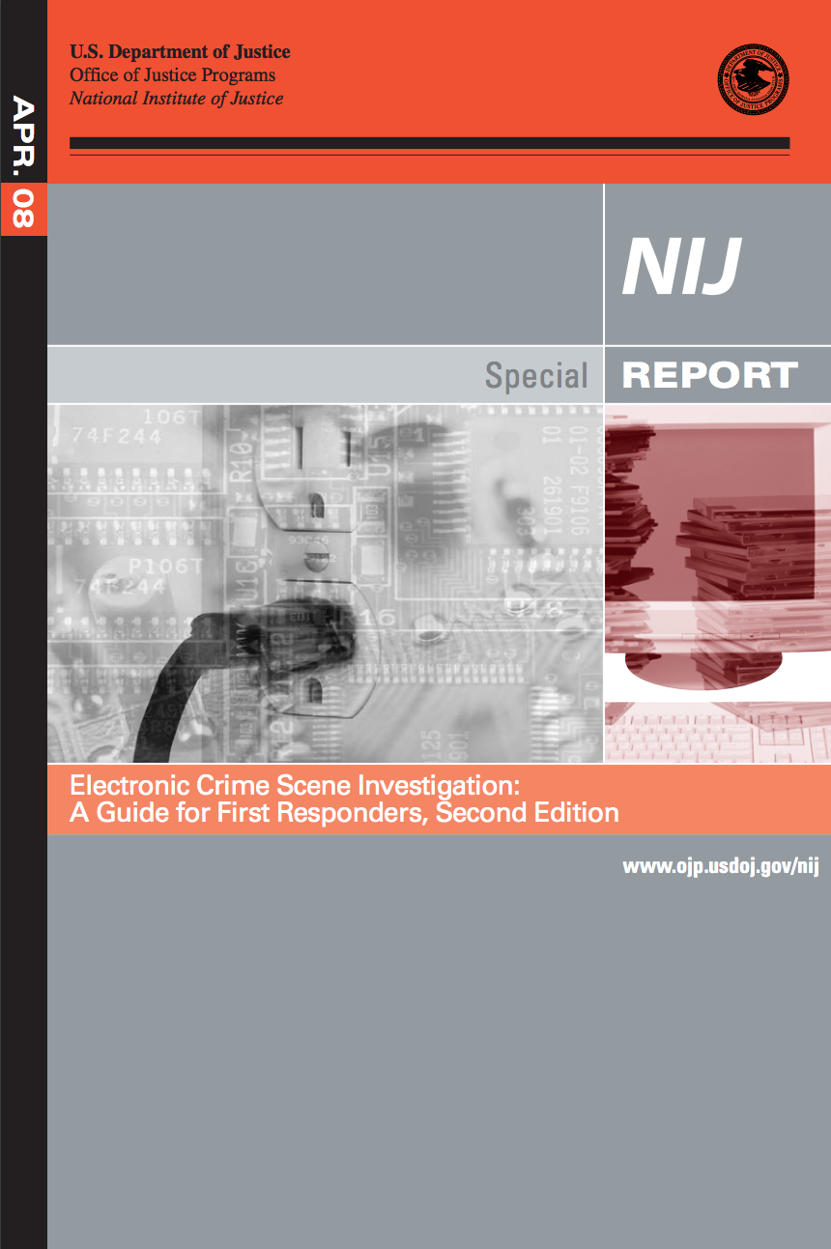
Police guidelines
Good practice guides issued by police and legal authorities:
What should be seized, what should be seized, how, etc.
[ACPO] Association of Chief Police Officers, UK
[NIJ04] National Institute of Justice, USA

Slide 69
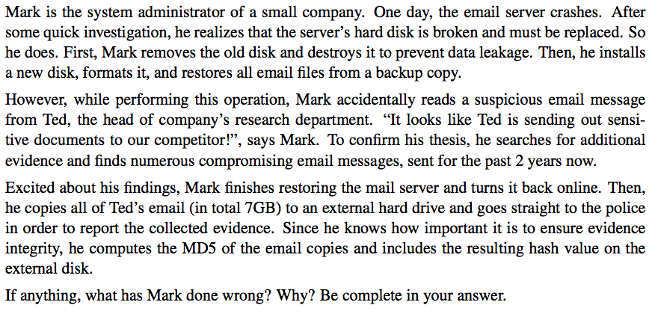
Exercise from a sample exam 2015/16

Slide 70
Segurança Forense Parte II: Aquisição de Prova Digital

Slide 71
Recall from the last class
The Kruse & Heiser investigation model
1.
Assessment
(Avaliação)
2.
Acquisition
(Apreensão)
3.
Analysis
(Análise)
4.
Reporting
(Apresentação)
Prepare plan of action, and find potential sources of digital evidence
Prevent changes of in situ digital evidence and collects them
Search for and interpret evidence trace in order to reconstruct the crime scene
Reporting of findings in a manner which satisfies the context of the investigation

Slide 72
What are we looking for? Digital artifacts
Digital artifacts: Part or entirely of the digital state of a computer system at a given time
Examples:
Videos, documents, audio recordings, emails, photos
Location data, social circles, cached content, communications data
Backup archives, web activity logs, configuration files, access control logs
…
Need to extract them from one or more computer systems

Slide 73
Our main concern when acquiring evidence
To preserve digital way in a way that:
Maintains an accurate representation of the original data, and
Maximizes its usefulness for decision makers, i.e., it is as complete as possible
Simply put:
We want to get the most evidence we can with the least amount of alteration
Notes:
Evidence must be preserved in a way that maintains its integrity and maximizes its usefulness for decision makers
To be forensically should, provided digital evidence must be handled in a manner that preserves a complete and accurate representation of the original data, and its authenticity and integrity can be validated

Slide 74
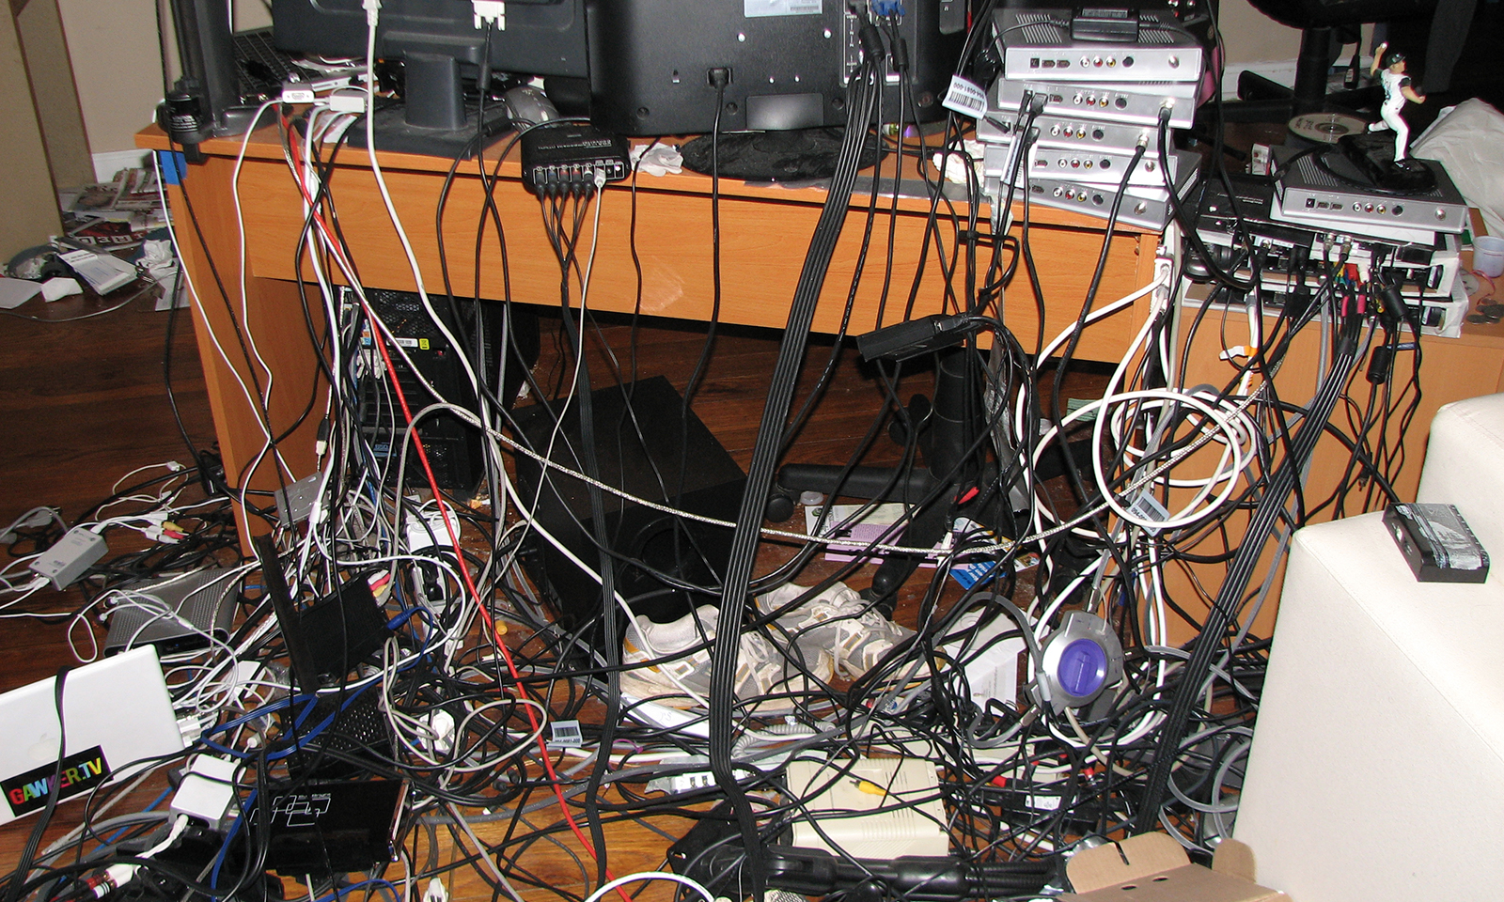
Today: collect evidence from the crime scene

Slide 75
Computer systems made simple
A computer system = graph of interconnected “boxes”
Outer boxes: computers holding potential evidence
E.g., servers, smartphones
Inner boxes: network components connecting outer boxes
E.g., routers, switches
Boxes provide sources of evidence
file
message
Notes:
Casey 15
Casey 21

Slide 76
Class roadmap
Tools for evidence acquisition
Obstacles to evidence acquisition
Evidence acquisition from computers
Handling mobile devices

Slide 77
Tools for evidence acquisition

Slide 78
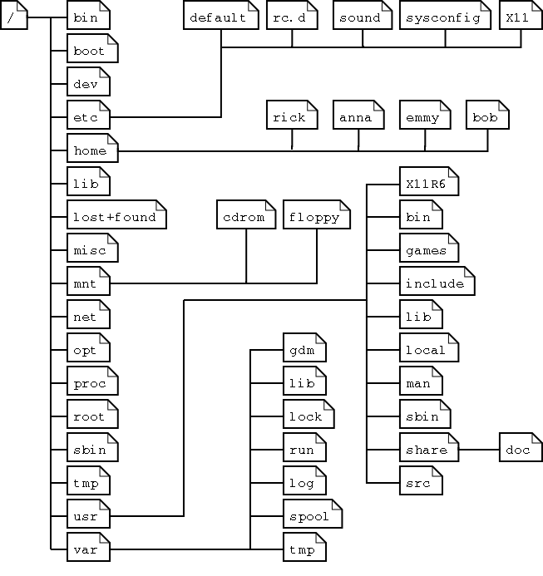
Forensic tools
Translate data through one or more layers of abstraction
Raw disk image
45 00 00 1d 7b bd 00 00
c0 a8 01 37 23 82 23 83
...
Input data
Rule set
Forensic Tool
Output data
Margin of error
File tree

Slide 79
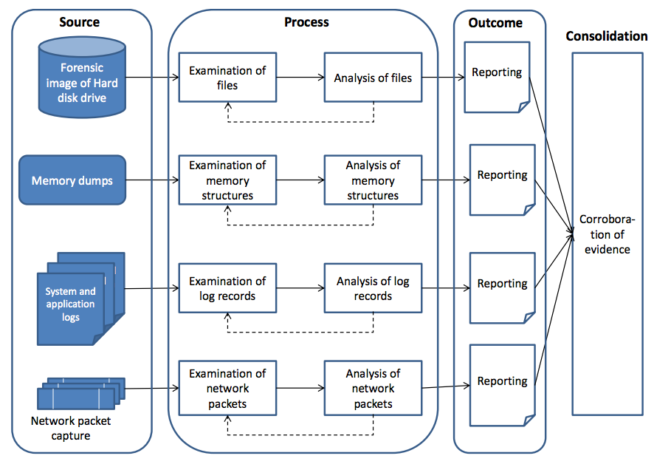

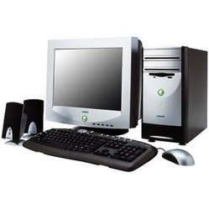

Typical workflow of forensic tool utilization
Arrows indicate steps where tools are used

Slide 80
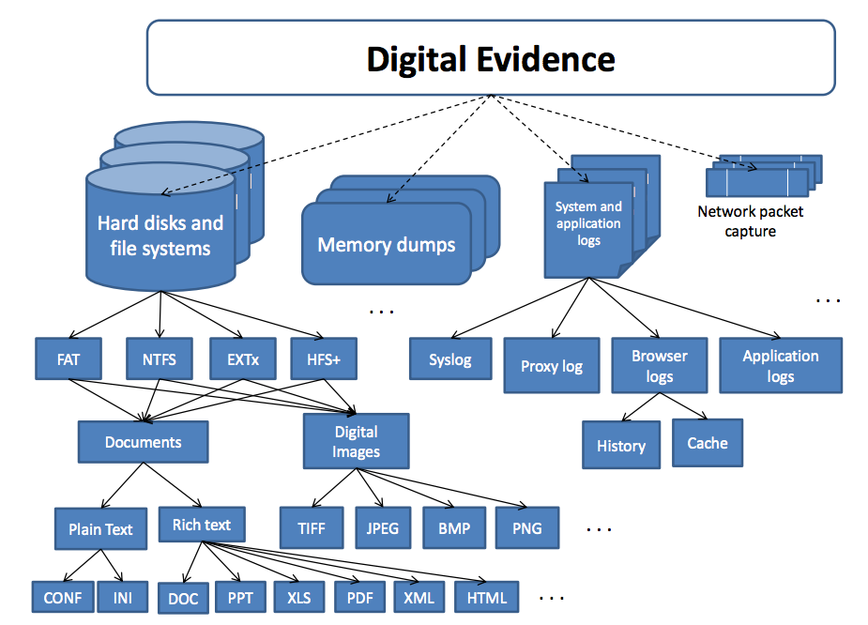
In the process, tools generate multiple data items
Notes:
http://eprints.qut.edu.au/72659/1/Sriram_Raghavan_Thesis.pdf

Slide 81
Ideal properties of forensic tools
Usability
Present data at a useful layer of abstraction for investigators
Comprehensiveness
Reveal all relevant data
Accuracy
The tool output error must be as low as possible
Determinism
Produce the same output when given the same rule set and input data
Verifiability
Be able to verify the results, either manually or using independent tool set
Performance
Notes:
Verification can be done by hand or a second tool set

Slide 82
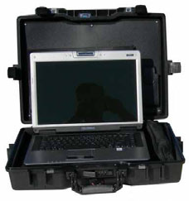
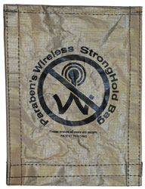
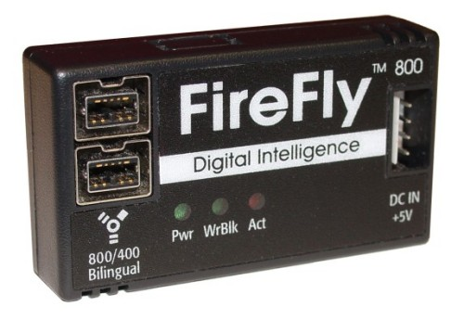
The first responder forensic toolkit
Backpack or case containing:
Mobile forensic workstation (laptop)
Bootable forensically-sound OS
Forensically clean storage devices for evidence collection: USB pen, external drive
Write blocker
Faraday bag
Other accessories: power cord, power adapters, network cables, power battery
Mobile forensic
workstation
Faraday bag
Write blocker

Slide 83


The forensics lab
Contains equipment for backing up evidence acquisition and supporting preservation and analysis of evidence
Crime Scene
Forensics Lab
Evidence Analysis
Workstation
Internet
Suspect Host
Evidence Acquisition
Server
Evidence Storage
Server
Mobile forensic
workstation

Slide 84
Obstacles to evidence acquisition

Slide 85
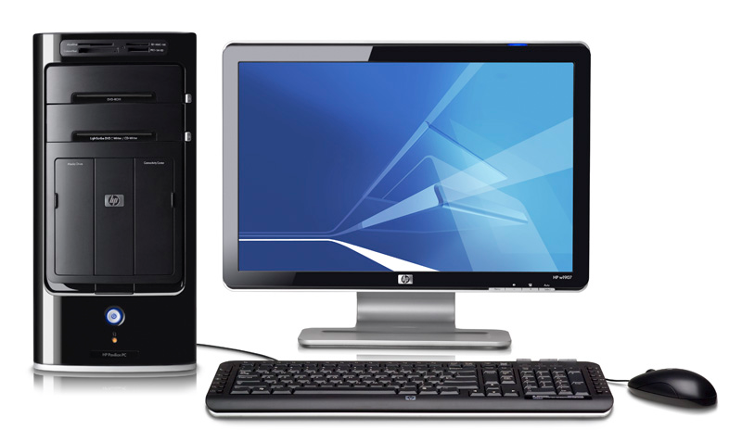
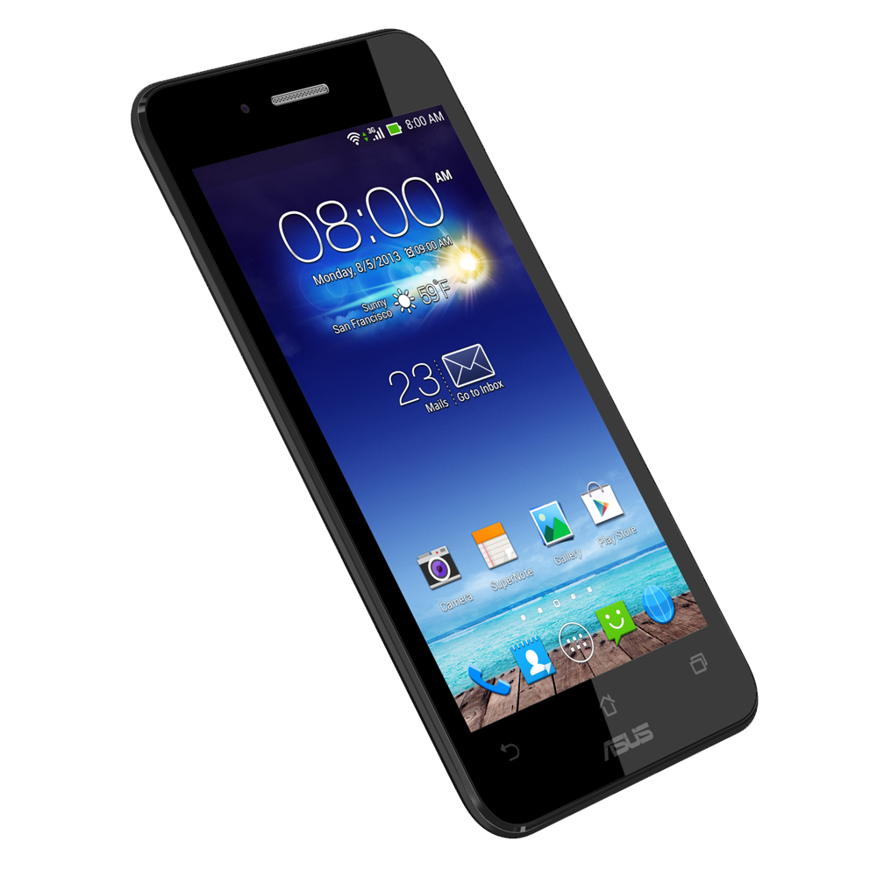
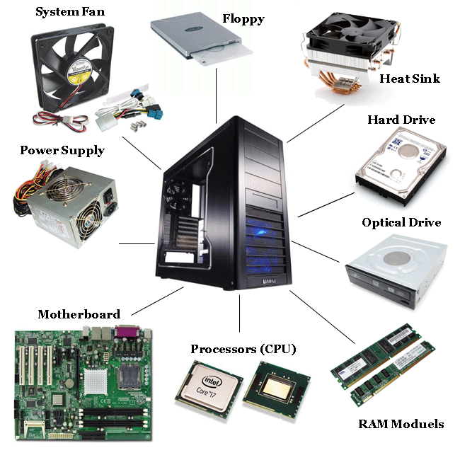
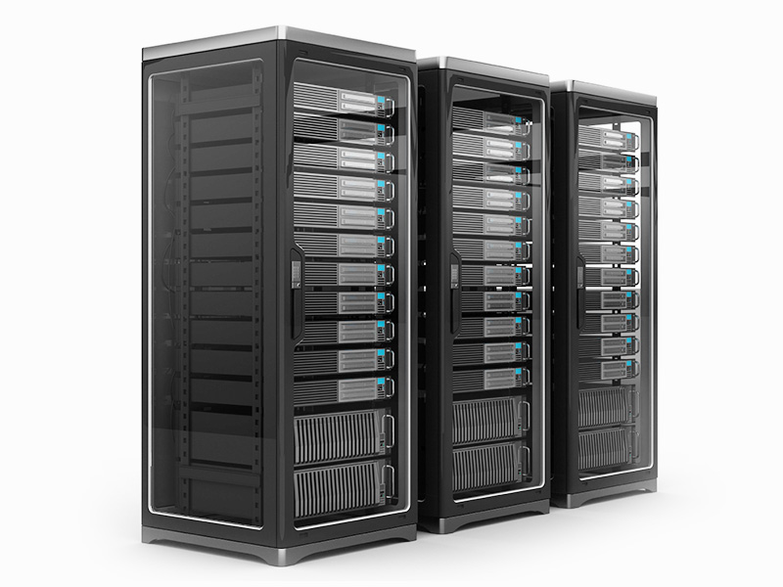
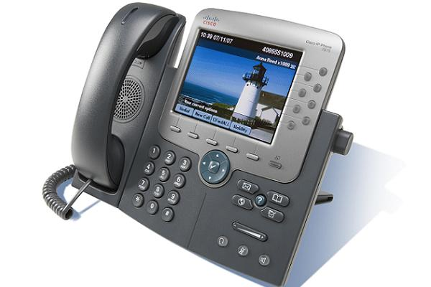
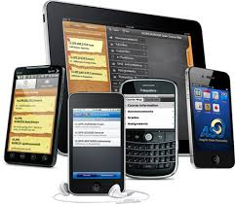

Obstacle #1: Heterogeneity of technology
Mobile
Desktop
Servers
Embedded
Variety of computer platforms
Diversity of hardware components
Variety of technologies for similar platforms
Multiple generations of hardware

Slide 86










Both hardware, software, and data
Desktop applications
Web applications
Server-side applications
Mobile applications
Operating systems

Slide 87

Computer architecture 101
Program execution flow: program loaded into memory then CPU executes its instructions: input data, process data, output data…

Slide 88

Where do digital artifacts reside?
All along the way in the memory and storage hierarchy

Slide 89
Obstacle #2: Dynamism of system state
The system state changes which may complicate the task of acquiring a consistent snapshot of evidence
Some parts of the system may change, but may not be relevant for the forensic analysis
The lower is the dynamism the higher can the accuracy be because we can obtain consistent data

Slide 90
Simple example: calculator program
Identify the digital artifacts left behind in memory after running this program
If you interrupt the process in different points
Input: 1 + 3
Snapshots:
A: arg1 = 1, arg2 = 0, res = 0
B: arg1 = 1, arg2 = 3, res = 0
C: arg1 = 1, arg2 = 3, res = 4
int main() {
int arg1 = 0;
int arg2 = 0;
int res = 0;
while(1) {
printf("Enter argument 1:\n");
scanf("%d", &arg1);
printf("Enter argument 2:\n");
scanf("%d", &arg2);
result = arg1 + arg2;
printf("Result: %d\n\n", res);
}
return 0;
}
A
B
C

Slide 91

Obstacle #3: Volatility of digital evidence
Tells how long data can survive in a system
The volatility level depends on whether:
A consistent power supply is required for storage
How fast data changes

Slide 92
Volatility level examples
More dynamic
CPU registers
Lost on
power
down
ARP cache
Process table
Open files
Buffer cache
Less dynamic
Logged users
Less
Volatile
More dynamic
Temporary files
Swap file
Survives
power
down
System logs
Documents
Images, videos
System settings
Less dynamic
Network topology

Slide 93
Obstacle #4: Accessibility of digital artifacts
Locally accessible
The investigator has access to the HW holding the data
E.g., file system of an apprehended computer or mobile device
Remotely accessible
Only remote access to the computer system where data lives
E.g., gmail account of known password by the investigator
Inaccessible
Cannot be retrieved no matter whether or not the forensic investigator is in possession of the host hardware device
E.g., encrypted file system w/ unknown key, private cloud store

Slide 94
Other factors that hurt data accessibility
Hidden data
Data hidden in slack space, metadata, or content-embedded
Deleted or stale data
Data in slack and unallocated space
Corrupted data
Bad sectors, damaged images, etc.
Encrypted data
Encrypted files or file systems

Slide 95


Obstacle #5: Potentially large amount of data
Data generated in 2010
1200 trillion gigabytes (1.2 zettabytes)
89 stacks of books each reaching from the Earth to the Sun
Would need more than 750 million iPods to hold it
Projection for 2020
35 zettabytes will be produced
= all words ever spoken by human beings written 7 times
Triage may be necessary

Slide 96
Data units
Just a quick reminder of the data units (in decimal system)
Data Unit | Analogy
1 Byte (8 bits) | A single character
1 Kilobyte (1,000 bytes) = 10³ bytes | A paragraph
1 Megabyte (1,000 KB) = 10⁶ bytes | A small book
1 Gigabyte (1,000 MB) = 10⁹ bytes | 9 meters of shelved books
1 Terabyte (1,000 GB) = 10¹² bytes | 1,000 copies of Encyclopedia
1 Petabyte (1,000 TB) = 10¹⁵ bytes | 2,000 years playing MP3 songs continuously
1 Exabyte (1,000 PB) = 10¹⁸ bytes | Streaming the entire Netflix catalog 3,177 times
1 Zettabyte (1,000 EB) = 10²¹ bytes | 250 billion DVDs, 36 million years of HD video,

Slide 97
Handling digital vs. physical evidence
Difficulty to find
Found in places known only by specialists or requiring very specific tools
Difficulty to interpret
Highly specialized knowledge is normally required to interpret the evidence
Volatility
Digital evidence can be easily overwritten or lost due to power loss
Tampering resistance
Digital evidence can be very easily modified or tampered with during evidence collection
Replication
Digital evidence can be copied indefinitely
Size
The amount of digital evidence can easily grow to very large proportions
Notes:
http://www.inm-lex.ro/fisiere/d_1284/Eectronic%20Evidence%20from%20seizure%20to%20trial%20-%20Nigel%20Jones.pdf
https://www.duo.uio.no/bitstream/handle/10852/39023/THESIS-xDUO.pdf?sequence=1 (search for “Differences between…”

Slide 98
Evidence acquisition from computers

Slide 99




Storage devices were found in crime scene
How to handle such devices?
External
Hard Drives
Hard Drives
Thumb Drives
Memory Cards

Slide 100
General procedure for handling storage devices
If you can take the device:
Tag, bag, create chain of custody, bring to lab for data extraction
Otherwise, perform data extraction on spot
Extract the data into the mobile station or upload it to remote lab server
Procedure for data extraction from the device:
Copy the data from the device without causing alterations
Calculate the hash
Create at least another copy (double check the hash)

Slide 101

Write blockers
Be very careful at mounting the storage device!
E.g., Windows creates thumbnails and recycle bin folders on plugged devices!
Write blockers allow acquisition of data from a storage device without changing the drive’s contents
Write commands are blocked
Only read commands are allowed to pass the write blocker
Types of blockers: hardware write blocker and software write blocker
Write Blocker
Forensic station
Source storage device

Slide 102



Hardware write blocker
HWB sits in between forensic station and storage device
Supported storage interfaces are ATA, SCSI, Firewire, USB or SATA
The forensic station’s controller cannot write values to the command register, which writes or erases data on the storage device

Slide 103

Software write blocker
SWB is a software layer that sits in between the OS and the device driver for the storage device
Prevents all disc requests that use sysem calls to write data to the storage device
Linux software write blocker
https://github.com/msuhanov/Linux-write-blocker

Slide 104
Methods for copying the data
Logical acquisition
Select relevant files to be copied from the device
Faster and takes up less space, but incomplete capture
Bit-stream copy
Exact bit-by-bit copy of the original storage medium
Capture includes meta-data and both active (known files) as well as inactive data (deleted file fragments)
The target can be to disk:
The destination disc must be wiped with zeros before the acquisition starts
The destination disc must not be mounted in the acquisiton system
The target can be to file, aka bit-stream image (e.g., image.dd)
The file can be saved on a hard disc or other storage media

Slide 105
Linux tools for image creation and inspection
Extract a disk image using the dd tool family
dc3dd if=/dev/sda3 of=/home/forensics/disk.img hash=md5 log=/home/forensics/disk.log
Mount disk image/partition read only:
mount -r /home/forensics/disk.img /mnt/mount_point
Obtain partition information:
sfdisk –l disk.img
fdisk –lu disk.img
Can split (and mount) the image to individual partitions
dd if=disk.img bs= 512 skip=xxx count=xxx of=partition.dd
Notes:
sfdisk reads and writes partition tables, but is not interactive like fdisk or cfdisk (it reads input from a file or stdin). It's generally used for partitioning drives from scripts or for partition table backup and recovery. Since it's command driven instead of menu driven, I can see the attraction for using it in documentation like this, since you can easily document the input.

Slide 106
Data acquisition over network
Write Blocker
Target server
Forensic station
Source storage device
It’s possible to create an image file over network
Transmitting data from source media over network and write data to file
How to:
First, the target computer (IP address 192.168.0.11) is prepared for the reception of data
netcat -l -p 9000 | dd of=file.dd
If the target computer is ready to start the transmission on the source computer is started
dd if=/dev/hda | netcat 192.168.0.11 9000

Slide 107

A computer has been found in the crime scene
The computer is off. What do you do first?

Slide 108
Powering up the computer may change data!
Some files changed on Windows XP power on
/WINDOWS/system32/config/system
/pagefile.sys
/hiberfil.sys
/Documents and Settings/NetworkService/Local Settings/History
/Documents and Settings/NetworkService/Local Settings/Application Data
/WINDOWS/Debug/PASSWD.LOG
/Documents and Settings/NetworkService/Local Settings/desktop.ini
/Documents and Settings/NetworkService/ntuser.ini
/Documents and Settings/NetworkService/Local Settings
/Documents and Settings/NetworkService/Local Settings/Temporary Internet Files
/WINDOWS/bootstat.dat
/Documents and Settings/LocalService/Local Settings
/Documents and Settings/LocalService/ntuser.ini
/Documents and Settings/LocalService/Local Settings/desktop.ini
/Documents and Settings/LocalService/Local Settings/Application Data
/Documents and Settings/qwert/Local Settings/Application Data
/Documents and Settings/qwert/Local Settings
/Documents and Settings/qwert/Local Settings/Temporary Internet Files
/Documents and Settings/qwert/Local Settings/desktop.ini
/Documents and Settings/qwert/ntuser.ini
/Documents and Settings/qwert/Local Settings/History
/WINDOWS/system32/config/SAM.LOG
/WINDOWS/Prefetch
...

Slide 109
What happens when the computer is turned on
Evidence can be tampered with or even destroyed!
Files in the boot process are modified
Autorun features / boot up scripts
Malware executed upon boot
If computer is off, leave it off
Notes:
http://forensicswiki.org/wiki/Files_changed_at_boot:Windows_XP

Slide 110
Check that the computer is powered down
The power cord it unplugged from the power socket
The computer’s power supply is turned off
The typical power and disk activity LEDs are off
No sound indicating hard disk activity

Slide 111

Seizing a computer
Using masking tape, tape over the power receptacle on the back of the computer
Bag the power cable in an evidence bag along with an evidence tag
If the computer is a laptop, open it and remove the battery; bag the battery with an evidence tag
Notes:
Next, using masking tape, tape over the power receptacle on the back of the computer. The idea here is to make it harder for someone to put the cable back and restart the computer and possibly taint the evidence. The other goal is to cover yourself. As a computer forensics investigator, you should do whatever it takes to avoid a computer being tampered with. Should any questions come up, you want to be able to state unequivocally that you followed standard operating procedures and the rules regarding chain of custody.
Bag the power cable in an evidence bag along with an evidence tag. The evidence tag should document the date and time, the case number, your name, the location where the cable was found, and other information depending on the policies and procedures of your investigation team.
If the computer is a laptop and it remains on after you pull the power cable, then it has a working battery. Find the power button and turn off the power. Then open the computer and remove the battery. Bag the laptop battery with an evidence tag. The computer should no longer be on after you do this, which is a good thing. Laptop computers can often communicate wirelessly. The computer might have been engaged in hacking into other computers, or the suspect might have still been communicating with the laptop, perhaps deleting incriminating files.
http://www.priscilla.com/forensics/computerseizure.html

Slide 112

What if you can’t bring the entire computer?
Bring the hard disks
Need to open the computer’s case and extract the hard disk
Then seize the hard disk
If you can’t bring the disk
Boot a trusted forensic OS (e.g., Kali) from DVD / USB drive
May need to access the BIOS first to update the boot sequence
Identify the device (under /dev) that corresponds to the source disk
Perform a logical or bit-stream copy of the disk
Note: use only the forensic tools of the trusted forensic OS!

Slide 113

What if the computer is turned on?
What do you do then?

Slide 114
Ordered shutdown may change the data!
Some files changed on Windows XP power off
/WINDOWS/system32/wbem/Logs/wmiprov.log
/WINDOWS/system32/wbem/Logs/WinMgmt.log
/Documents and Settings/qwert/NTUSER.DAT.LOG
/Documents and Settings/qwert/NTUSER.DAT
/Documents and Settings/qwert/Local Settings/Application Data/Microsoft/Windows/UsrClass.dat
/Documents and Settings/qwert/ntuser.ini
/WINDOWS/system32/wbem/Repository/FS
/WINDOWS/Tasks/SA.DAT
/WINDOWS/system32/wbem/Repository/FS/OBJECTS.MAP
/WINDOWS/system32/wbem/Logs/wbemess.log
/WINDOWS/SchedLgU.Txt
/WINDOWS/system32/wbem/Repository/FS/INDEX.MAP
/WINDOWS/system32/config/SysEvent.Evt
/WINDOWS/system32/config/software.LOG
/WINDOWS/bootstat.dat
/WINDOWS/inf/wkstamig.inf (deleted-realloc)
/WINDOWS/system32/config/software
/Documents and Settings/NetworkService/Local Settings/Application Data/Microsoft/Windows/UsrClass.dat
/WINDOWS/system32/config/system.LOG
/Documents and Settings/LocalService/Local Settings/Application Data/Microsoft/Windows/UsrClass.dat
/WINDOWS/system32/config/system
/WINDOWS/system32/config/SECURITY
/Documents and Settings/NetworkService/NTUSER.DAT
/Documents and Settings/LocalService/NTUSER.DAT
/WINDOWS/system32/config/default
/WINDOWS/system32/config/SAM

Slide 115

Pull the power plug?
In the past, most computer forensics experts recommended pulling the power cable on a computer right away, even if the computer is running
Most experts agreed that you should not go to any extraordinary efforts to gather volatile data stored in RAM
Notes:
http://www.priscilla.com/forensics/computerseizure.html

Slide 116
Advantages of pulling the power plug
May help preserve evidence, for example:
Any script the suspect has written that should execute upon shut-down doesn't get a chance to run
Temporary word-processing and other interim files remain on the hard drive, whereas they might get deleted if the software applications shut down more gracefully

Slide 117
Disadvantages of pulling the power plug
Information may be lost by virtue of the volatility of data
Computers have large amounts of RAM which maintain process context information, network state information, and much more
Once a system is powered down, the immediate contents of that memory are lost and can never be completely recovered
Examples:
On a suspect’s computer there is a important message stored in RAM that will be lost if the computer is unplugged
In network intrusions, it is usually desirable to capture information related to active processes and malware resident in memory

Slide 118

A similar dilemma: Unplugging the network cable
To prevent anyone from accessing systems from outside the crime scene, it is generally advisable to disable network connectivity to all computer systems
However, this action can destroy evidence and eliminate investigative opportunities
Notes:
Casey11, p 246

Slide 119
Problems with disconnecting the network cable
The opportunity to list the active connections to the system is lost: investigators may never know which other computers on the network might contain evidence
In certain cases such as network intrusions, disconnecting network connections may eliminate an opportunity to gather network traffic of the perpetrator in action
Furthermore, it can seriously impact a business: disconnecting an e-mail server or an e-commerce site’s main transaction server can cause significant losses

Slide 120
First observation to make
Is the system password protected?
If there are logged-in accounts, switching off the computer may result in loss of credentials and prevent you from logging back in
If not, pull the power plug: there’s not much one can do
Otherwise, it may be necessary to perform live forensics
For example, if a user account is logged on, switching down the computer may result in loss of user credentials

Slide 121
Live forensics
So, it may be necessary to perform operations on a system that contains evidence, especially in networked systems
Live forensics vs. dead/postmortem forensics
Live: analysis is done on a live system
Dead/postmortem: analysis done on powered off system
General procedure for live forensics:
The evidence system must be running and logged in
Ideally, run forensically sound tools from DVD or USB stick
Collect evidence to external storage or network share
Create log entry for every single command you execute

Slide 122
Useful data to collect in live analysis
Files and network connections
List open files
lsof -nDr
List network connections
netstat -nap
List network routes
netstat -nr
List deleted and open files
ils -0 /dev/hdaN
List network addressess
ifconfig
Processes
List processes
ps -auxl | $nc # linux: suspect processes
Capture process memory
pcat <PID>
Users
List active users
who -iHl
Obtain system information
tar cf - /proc

Slide 123
Useful data to collect in live analysis
Memory
Memory dump
volatility
Swap space
dd if=/dev/SWAPdev bs=2k
Volumes and file systems
Encrypted volumes
dd if=/dev/hdaN bs=2k
Temporary partitions
dd if=/dev/TMPdev bs=2k
File access times
ls -alRu
System-specific structures
Windows registry
Windows event log
Applications
Browsers
Password caches
Web cache
Cloud applications
Dropbox, Google Drive
Messaging & social networks
Email clients
Facebook and Twitter accounts
Note that which data is relevant depends on the case under study

Slide 124
Risk assessment necessary before live capture
Types of information that may be: running processes, network connections, and data stored in memory
Memory may contain: decrypted applications, cryptographic keys, passwords, code that has not been saved to disk, etc.
It may be worthwhile considering manual closure of various applications, but requires expert knowledge
Closing Microsoft Internet Explorer will flush data to the hard drive, thus benefitting the investigation and avoiding data loss
However, closing KaZaA, could result in the loss of data

Slide 125
Collect evidence by which order?
To ensure all relevant data are collected, you should prepare an order of volatility while gathering evidence
The order should be from the most volatile to the least
Example of an OoV in a network intrusion investigation:
ARP cache
Process table
Kernel statistics and modules
Logs
User files
Least
volatile
Notes:
http://news.asis.io/sites/default/files/Evidence_Collection_Preservation.pdf
https://www.ietf.org/rfc/rfc3227.txt

Slide 126
Summary of decision process in live forensics
Identify computer system, secure scene, and preserve trace evidence
Keep it off!
no
yes
no
Computer
on?
Screen
saver?
yes
Photograph, label, document, disconnect network, power cables. Collect peripherals, removable media, etc.
Move mouse
Disconnect power
yes
no
Password
prompt?
yes
Destruction
in progress?
yes
no
Collect digital evidence that is
needed
no
Document screen, system time, and network activity. Preserve volatile data if needed
Computer
required?

Slide 127
Summary of approaches to data preservation
What to preserve | Implications
Original hard drive | Any operations that are needed can be performed. Physical damage / failure of the original hard drive may render its contents inaccessible
Forensic duplicate of original hard drive | The entire contents of the hard drive are preserved, including deleted data. This is generally done performing a bit-stream copy. However, it may be infeasible or not permitted under certain circumstances (e.g., very large hard drives, legal protection of certain files)
Select files from original hard drive | Other files on the hard drive that may be relevant will not be preserved, and deleted data will not be preserved. Furthermore, for the selected files, important information or metadata may be lost or misinterpreted during acquisition.
Converted versions of files from original hard drive | For the selected files, important information or metadata may be lost or misinterpreted during conversion
Relevant portions of files from original hard drive | Digital investigators only know what is relevant at a certain moment and may miss some relevant information, particularly if new facts come to light later
Written notes detailing portions of files | The approach does not preserve the original digital evidence and is not feasible with large amounts of data
Notes:
More on evidence collection methods (Table 16.1, Casey11, p. 487)

Slide 128
Handling mobile devices

Slide 129



Mobile devices were found in crime scene
How to acquire the data from such devices?
Mobile Phones
Smartphones
PDAs

Slide 130

Where mobile devices store their data
Android applications primarily store data persistently in two locations: internal and external storage
External data storage (SD card)
Data can be stored in any location
Internal data storage
The location is predefined and controlled by the Android APIs
Internal data of all apps is saved in /data/data/<apppkg>
E.g., e-mail client location /data/data/com.android.email
Notes:
http://en.calameo.com/read/002857878fa653eb15e86

Slide 131
What’s special about data acquisition in mobiles
Can’t remove persistent memory off the device
Depend on the device’s firmware / OS to access the data
The firmware / OS of the device restricts access to data
E.g., Android’s debug bridge can’t read app’s private data
Linked with outside world via wireless
Commands issued via 4G and WiFi may cause data destruction
Depend on battery for power supply
Data may get lost (or made inaccessible) when battery runs out
Notes:
Android devices have two primary types of memory:
Volatile: random-access memory (RAM)
Non-volatile: NAND flash memory
NAND flash
Critical for forensic investigation
MCP
RAM and NAND in a single component named multichip package
http://embedded-computing.com/articles/multichip-next-generation-internet-things-connectivity-automotive/
http://www.techeye.net/chips/samsung-mass-produces-multi-chip-package-memory
http://www.neowin.net/news/guide-to-smartphone-hardware-37-memory-and-storage
http://www.neowin.net/news/guide-to-smartphone-hardware-17-processors

Slide 132

A smartphone was found in the crime scene
What do you do first?
Assume that it’s powered down

Slide 133


Brind the device and power and data cables
It is always prudent to seize the cables directly from the scene
It’s possible that a newer device is in use and the forensic toolkits do not yet have an appropriate cable

Slide 134

Smudge attack
Infer the lock pattern from the oil smudge left on the display’s surface
First responders must minimize contact with the screen

Slide 135

What if the device is powered on?
What do you do first?
Assume that it’s powered on

Slide 136

If unlocked, network isolation
Crucial to isolate the device from the network
In the worst case, a remote wipe could be initiated on the device
In other circumstances, additional messages can be received or removed by triggers outside our control
Isolation should prevent reception of new calls, messages, or commands that could alter or destroy evidence
Need to cover several wireless interfaces:
GSM, WiFi, BT, etc.

Slide 137






Ways to isolate the device
Place the device in Airplane mode
Suspend account with carrier
Place the device in a Faraday bag: shield the interior from external electromagnetic radiation
Remove the SIM card
Turn off the device

Slide 138
Network isolation techniques: pros & cons
Technique | Advantages | Disadvantages
Put the device in Airplane mode*. Requires full access to the Settings menu | The device continues running and temporal data remains intact. Disables cellular data net and WiFi | You are modifying the device setting further. Only works if you have full access to the device
If the phone is a GSM phone, remove the SIM card | Easy to remove, effective in disabling all cellular voice, SMS, and data transmissions | Does not disable WiFi
Suspend account with wireless carrier | Effective at disabling all cellular voice, SMS, and data transmissions | Process may take some time and require court order, does not disable WiFi
Place device in shielded bag, box, tent, or room | Faraday shields prevent various types of network transmissions; good if cannot use any previous options | Debate about effectiveness of portable bags. Could drain the battery. Cords cannot be inserted in bag.
Turn the device off | Completely effective in preventing all network transmissions | The device state is modified; temporal data is lost. Pass code on reboot could be enabled
* The best option is probably placing the device in Airplane mode

Slide 139

Exercise from 2nd exam 2016/17

Slide 140
Conclusions
Data acquisition is a task that poses a number of obstacles for the forensic analysis
To forensically acquire data from computers, many factors must be considered, e.g., whether to power off the computer, unplug the network cord, etc.
When handling mobile devices, care must be taken about network isolation and battery usage.

